Slide 1
Intelligent system for customs control of baggage
Henrik LARSEN
henrik@legind.com
Legind Technologies A/S
Role: Proposal coordinator
Proposal activity: CL3-BM-01-04: OPEN TOPIC
Presented by:
Hassane ESSAFI
hassane.essafi@cea.fr
Henrik LARSEN henrik@legind.com

Slide 2
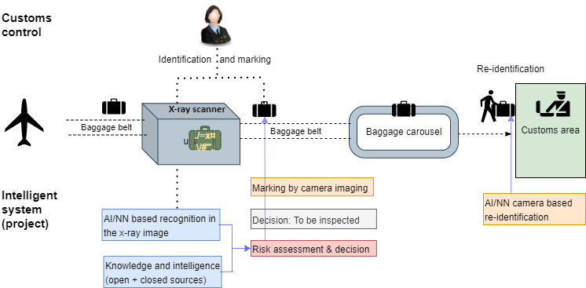
Proposal idea/content
Challenges in customs control of passenger baggage from arriving international flights:
identification and marking of suspect baggage (containing contraband)
re-identification for inspection when carried out through the customs area
The project aims at developing an effective intelligent (AI/NN based) solution for this.
Henrik LARSEN henrik@legind.com

Slide 3
Project participants
Existing consortium:
Proposed coordinator: Legind Technologies A/S
Partners / Other participants (tbc): Customs, technology providers (including software and image/ object recognition), equipment providers (x-ray scanners, cameras). Countries: Denmark, Spain, France, Netherlands.
Looking for partners with the following expertise/ technology/ application field:
Customs
(Airport) Border guards / LEAs
X-ray image/object recognition
Usability design (as relevant to the envisioned product)
Henrik LARSEN henrik@legind.com

