Slide 1
Smart Illicit Object Detectors for Smart Security Checkpoints
Gilles Santi
gilles.santi@sedect.aero
SEDECT SA (Gland, Switzerland)
Role: S/T provider or WP leader
Proposal activity:
Open topic (CL3-2022-BM-01-04 / CL3-2022-BM-01-05)
Relevant topics from 2021:
Improved border checks for travel facilitation across external borders and improved experiences for both passengers and border authorities’ staff (CL3-2021-BM-01-03)
Improved detection of concealed objects on, and within the body of, persons (CL3-2021-BM-01-05)
Gilles Santi, gilles.santi@sedect.aero, SEDECT SA

Slide 2
Smart checkpoint through tracking and smart detection devices
Person preparation process: multi-steps
Improved and seamless people flow through security
Aggregation of partial responses from several detectors
Requires (anonymous) person tracking in preparation area
Multi-detector person
preparation process
(evolving readiness status)
Gilles Santi, gilles.santi@sedect.aero, SEDECT SA

Slide 3
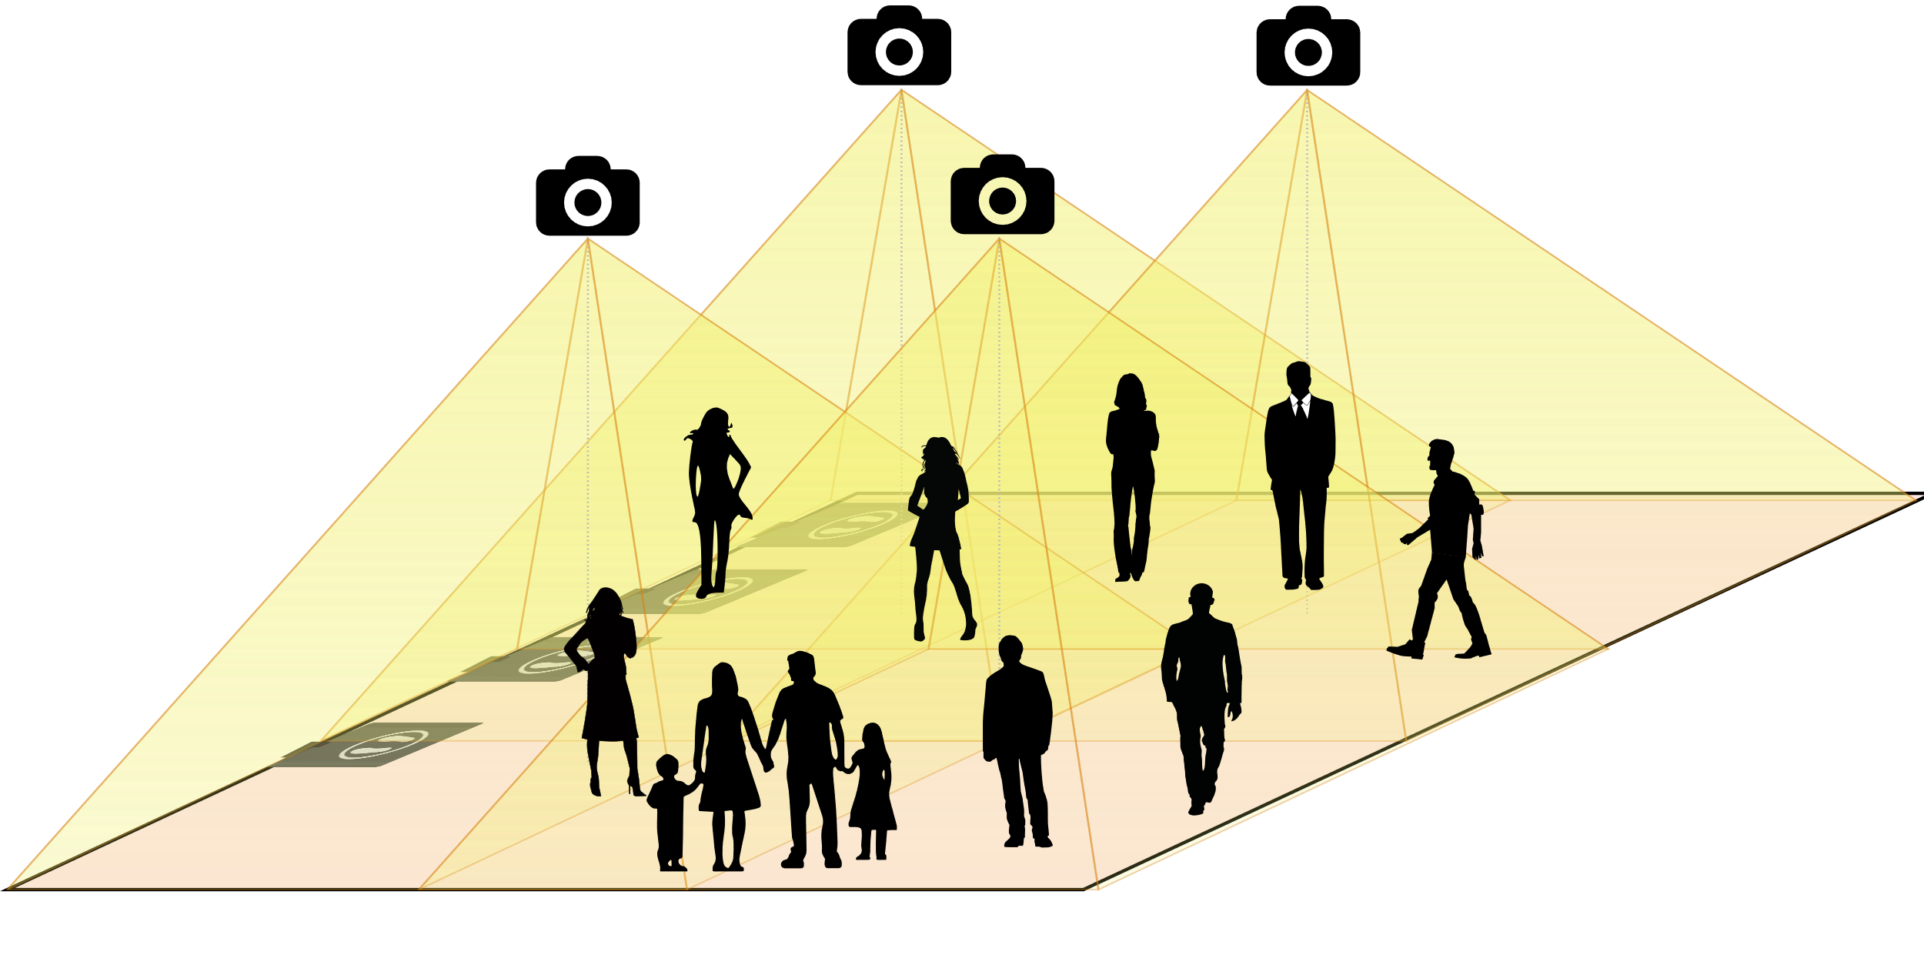
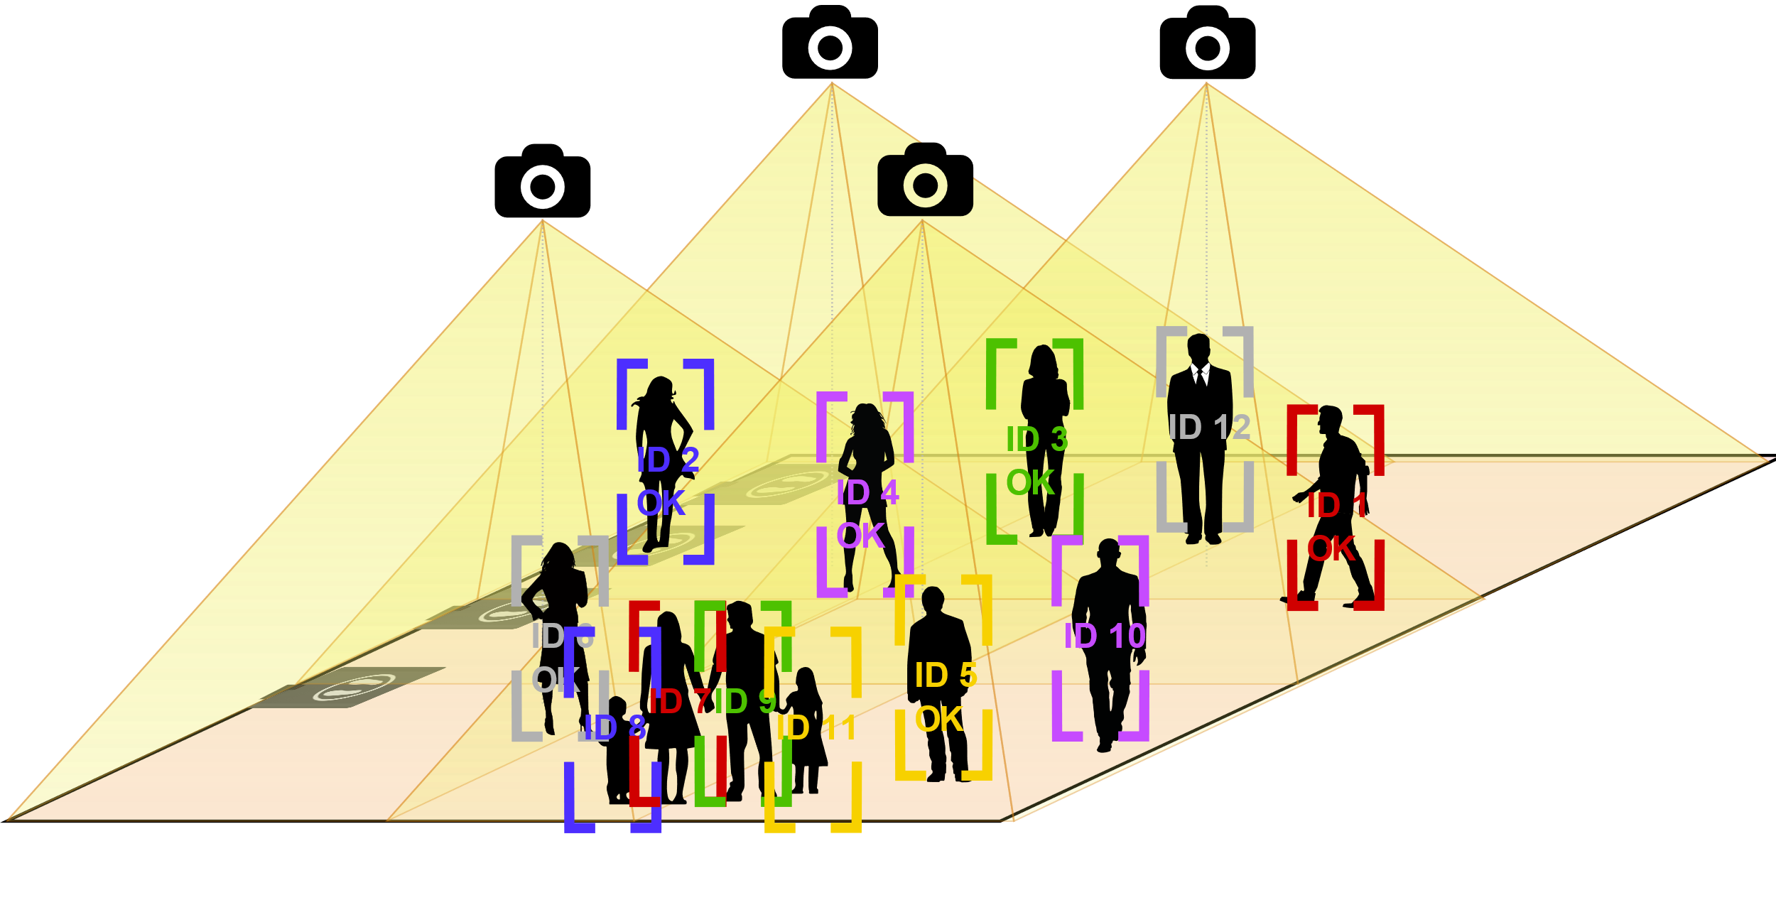
Smart checkpoint through tracking and smart detection devices
Preparation area
Tracking over area
IDs with status
Full paths with events
Threat scanners
@ divest stations
Multi-detector person
preparation process
(evolving readiness status)
Gilles Santi, gilles.santi@sedect.aero, SEDECT SA

Slide 4
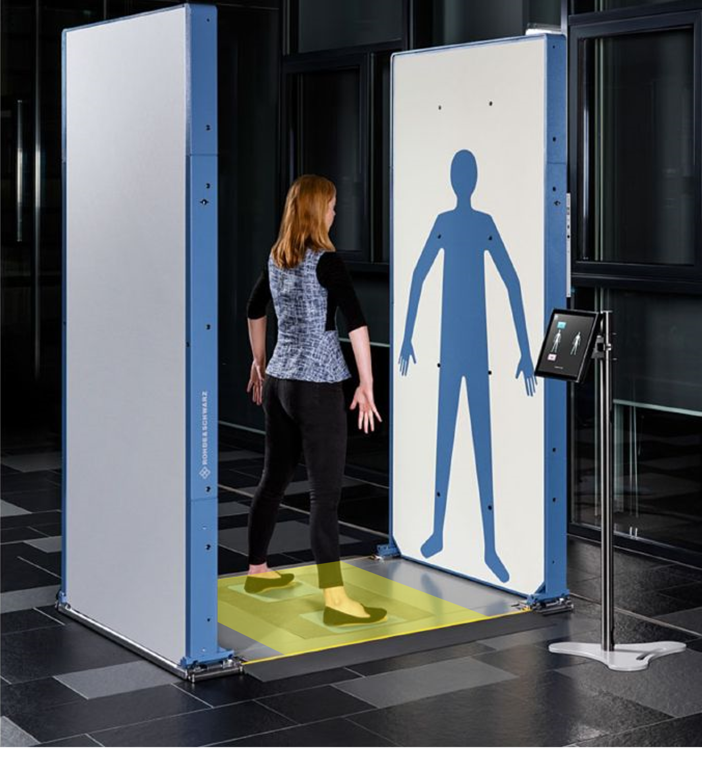
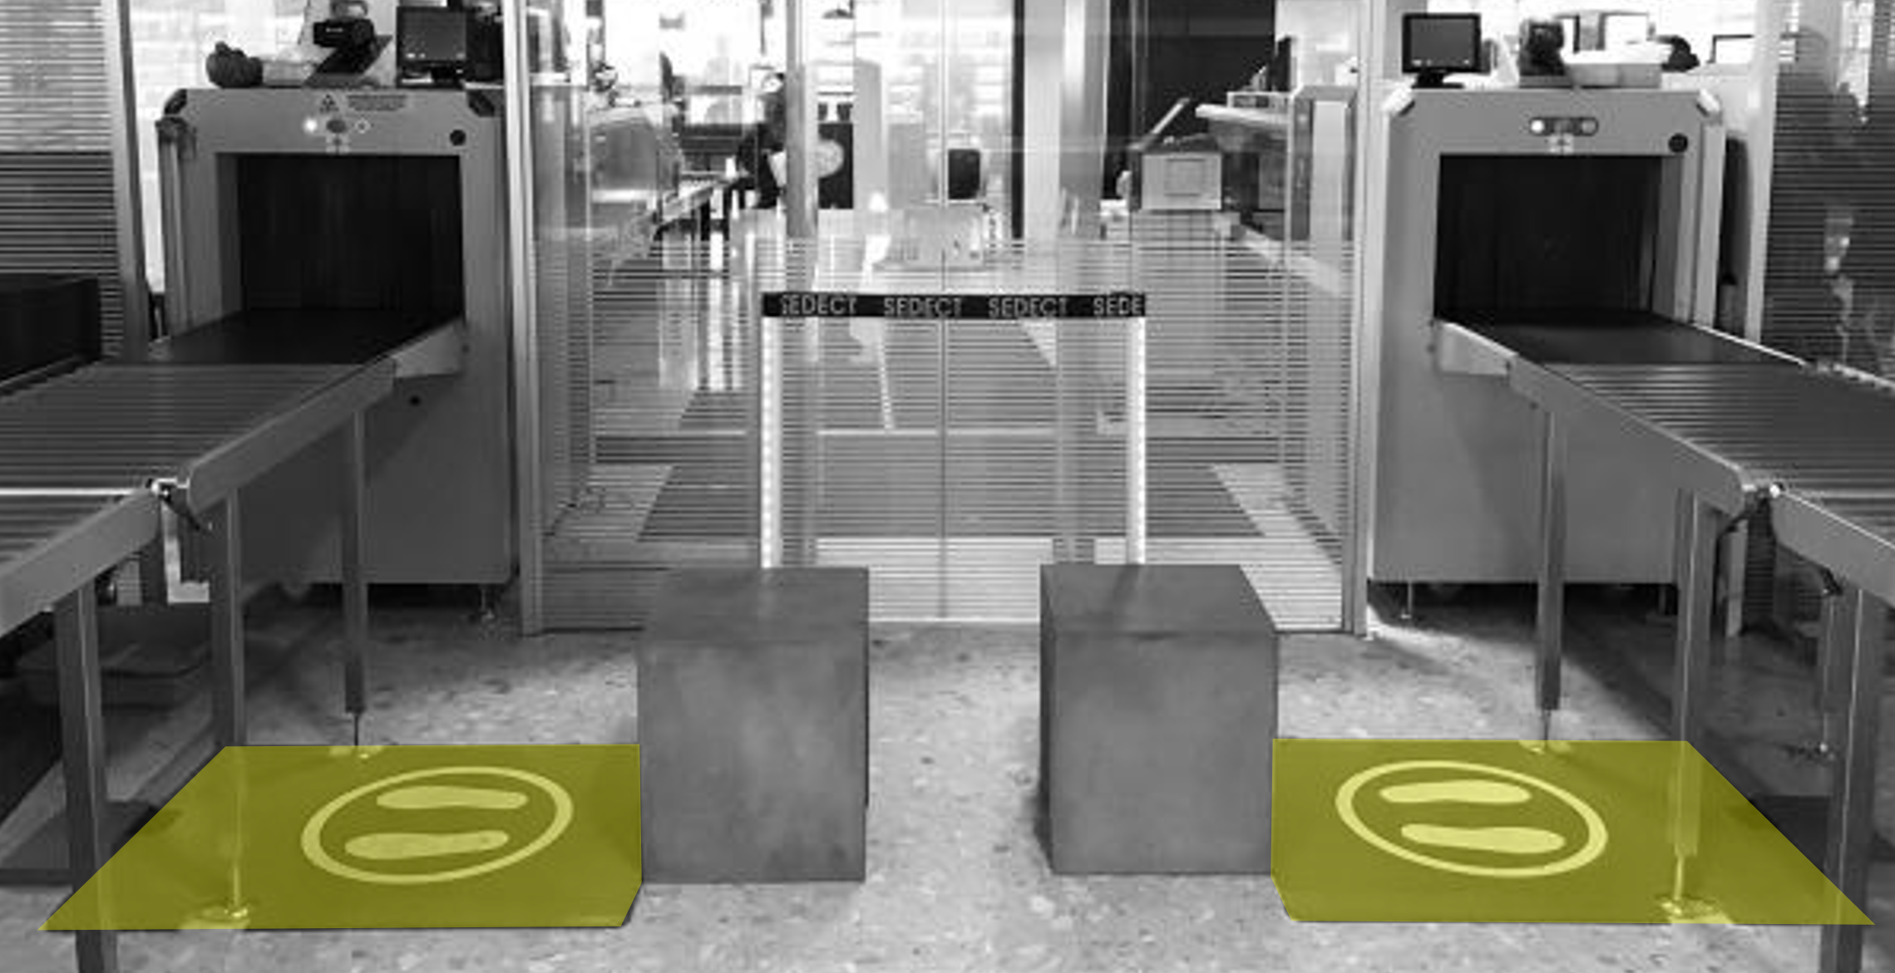
We develop unique sensing systems for the best body scanners
Collaboration with equipment leader
Focus on detection of threats in lower body parts (shoes)
Metal (TRL 8) and non-metal (TRL 5) threat detection
Non-ionizing detection technique (low frequency electromagnetic)
Standalone
Our contribution to
the body scanners
Gilles Santi, gilles.santi@sedect.aero, SEDECT SA

Slide 5
Project participants
Looking for partners with the following expertise/ technology/ application field:
People tracking
Device networking in secure environments
Real-time data aggregation
Gilles Santi, gilles.santi@sedect.aero, SEDECT SA

