Slide 1
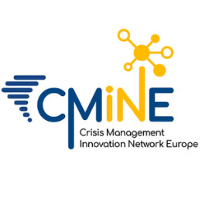
Welcome to
Supported by
www.cmine.eu
The Crisis Management & Innovation Network
www.smi2g.eu

Slide 2
What is CMINE?
Free & Informal Network
Aims to connect the Horizon Family
Born of DRS but
Increasingly Supports
SSRI
FCT and
Other programmes
Champions of the Cluster Approach

Slide 3
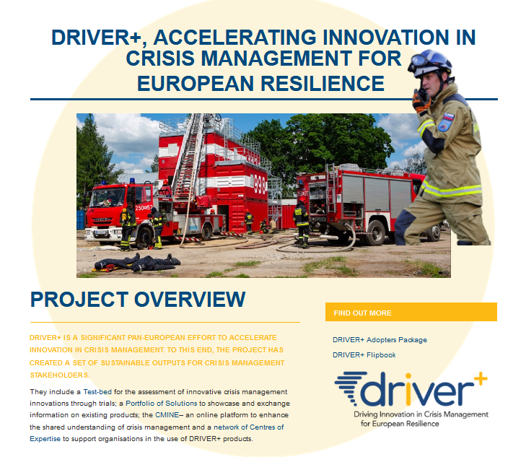
Where it Came From:
Funded by the European Commission as part of the sustainability strategy for Driver+ under grant agreement ID: 607798.
It is maintained by the Resilience Advisors Network under a Memorandum of Understanding with the European Research Executive Agency and
is supported by research grants from current projects.

Slide 4
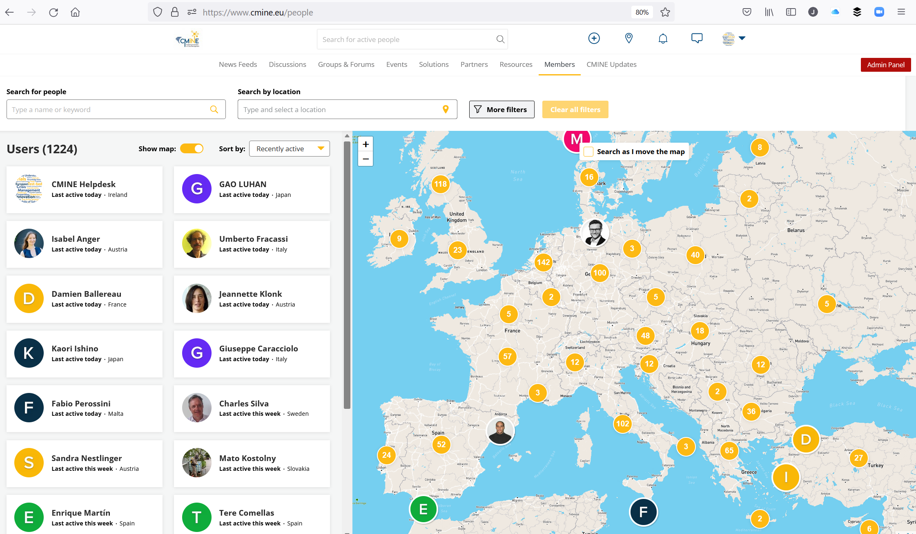

Slide 5
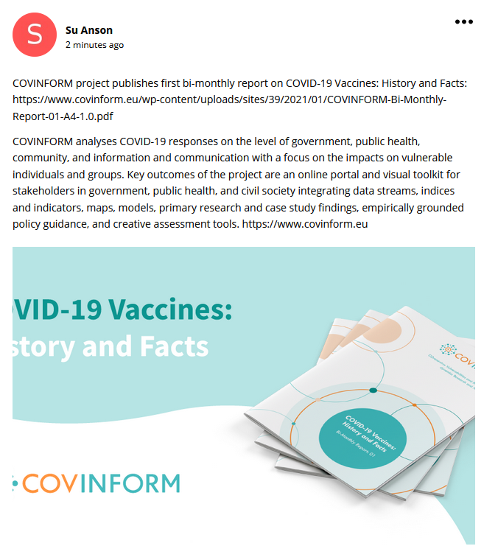
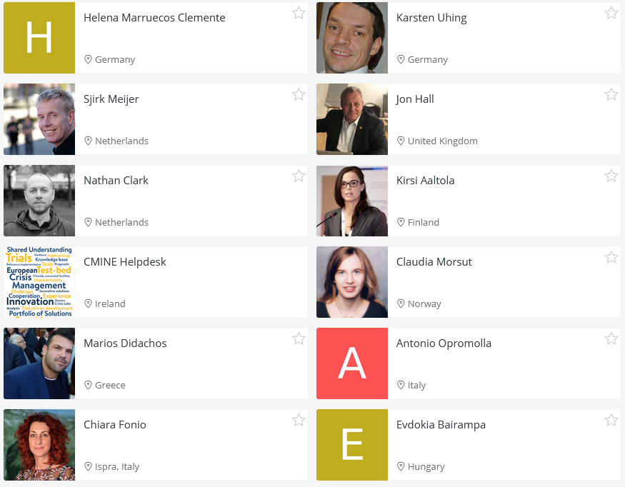
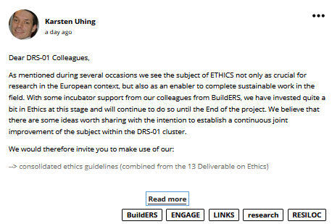
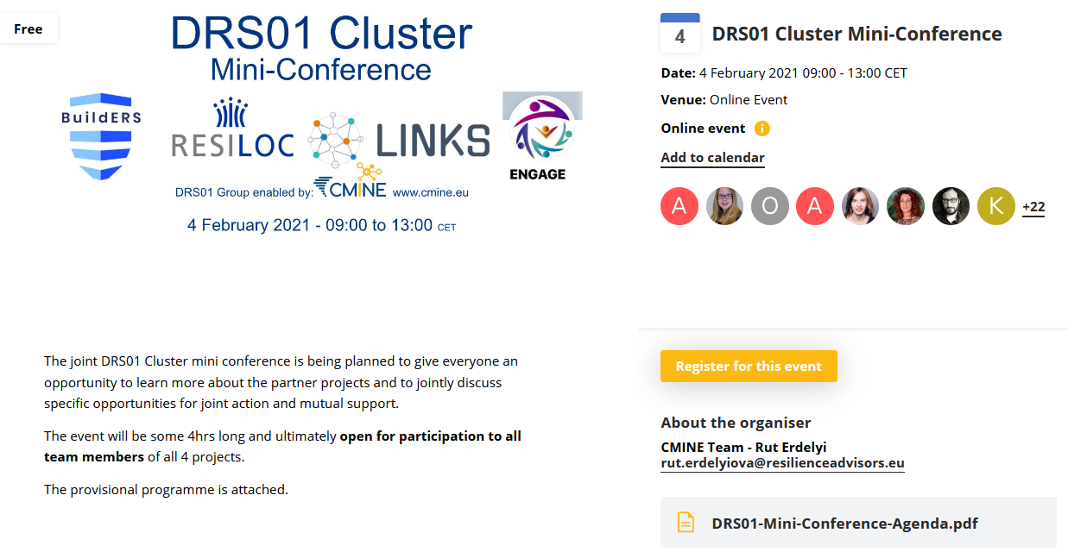
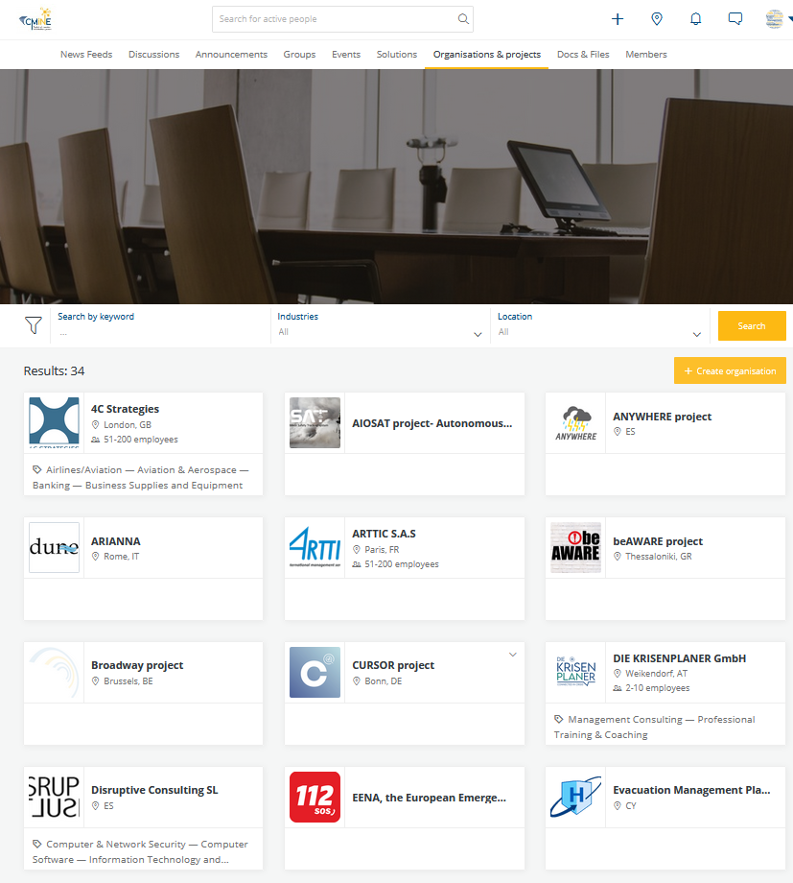
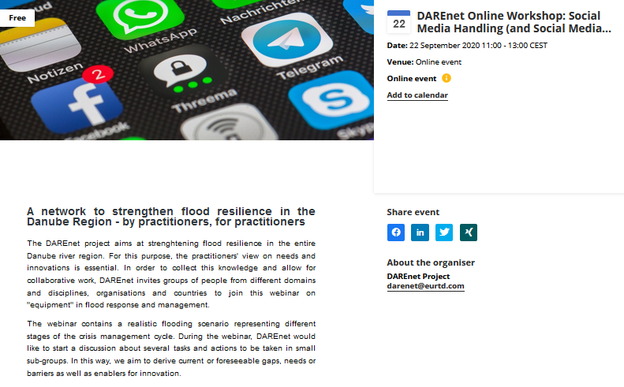
Its website supports:
Project Groups & Clusters
Fact Finding
Promoting & Managing Events
Online Surveys
Result Dissemination
Project Sustainability

Slide 6
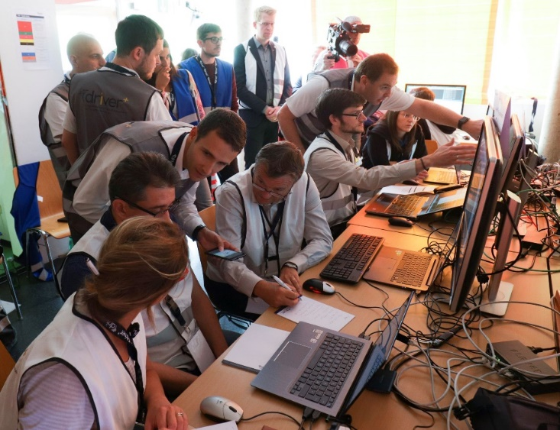
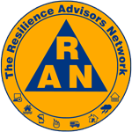
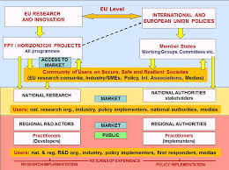
CMINE Today!
Custodians (RAN)
Moderators & Maintenance
Self sustaining (7 Years+)
Funding ongoing (projects)
Supporting:
Many projects in the room
Clusters (eg DRS01)

Slide 7
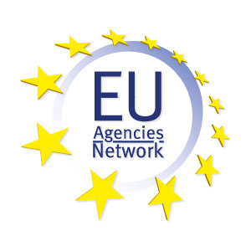
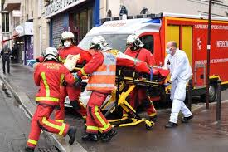
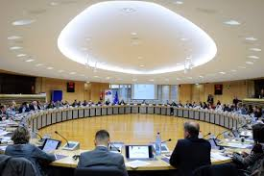
Please remember…
Many networks already exist
Here to stay
Use us for events & Dissemination
Include CMINE in your Proposals

Slide 8
An Incredible & Unique Knowledge Base
www.cmine.eu

