Slide 1
Technologies to monitor and analyse cybersecurity incidents @edge
Marie-Sophie Masselot
marie-Sophie.masselot@cea.fr
CEA-Leti’ technology : Integrated monitoring and recovery component for embedded devices (IoT and edge – “host-based IDS”)
Role: WP Leader, Technology provider
Proposal activity: CS-01-01: Improved monitoring of threats, intrusion detection and response in complex and heterogeneous digital systems and infrastructures (IA)
demonstration prototypes of tools and technologies to monitor and analyse cybersecurity incidents in an operational environment
Marie-Sophie Masselot – marie-sophie.masselot@cea.fr

Slide 2
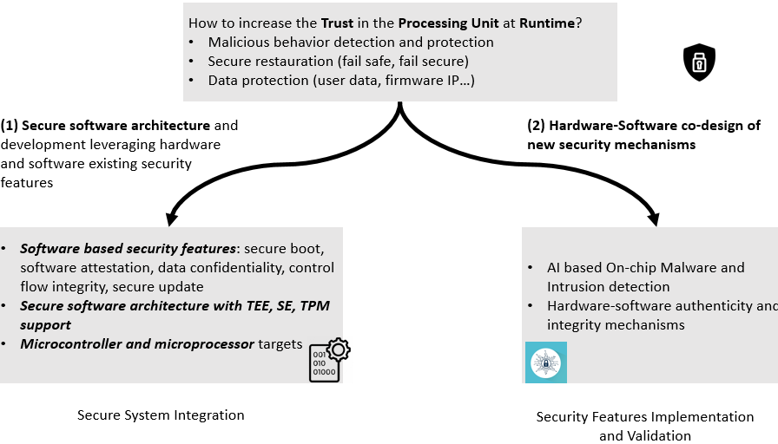
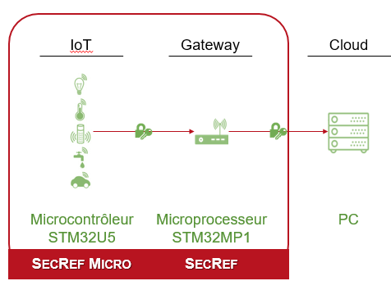
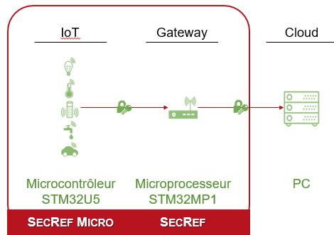
Technologies to monitor and analyse cybersecurity incidents @edge
Technologies to monitor and analyse cybersecurity incidents @edge
Marie-Sophie Masselot – marie-sophie.masselot@cea.fr

Slide 3
Project participants
Looking for partners with the following expertise/ technology/ application field:
Industrial partners in medical devices, industrial systems, IoT partner
Cyberthreat intelligence systems providers
End-users of hardware devices intrusion detection and resilience
Marie-Sophie Masselot – marie-sophie.masselot@cea.fr

