Slide 1
Connected and Automated Mobility (CAM) Cybersecurity
Lara Valentin : lvalentin@funditec.es
Alejandro Echeverría – Technical coordinator: aecheverria@funditec.es
FUNDITEC – Madrid Technological Center
Role: Proposal coordinator
Proposal activity:
HORIZON-CL3-2022-CS-01-01
Improved monitoring of threats, intrusion detection and response in complex and heterogeneous digital systems and infrastructures
Lara Valentín, lvalentin@funditec.es

Slide 2
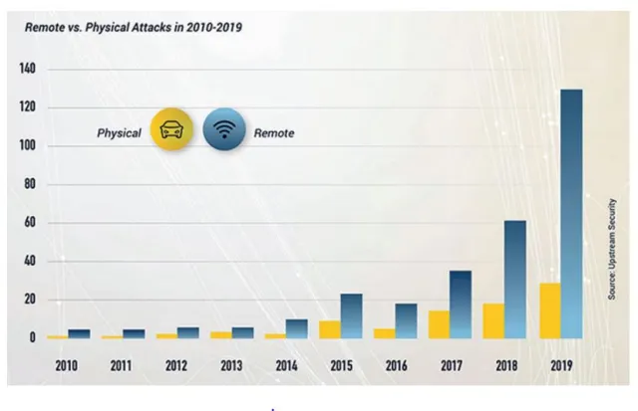
Connected cars are open to cyberattacks Automotive embedded applications were traditionally isolated, static, fixed-function, device-specific implementations, and practices and processes have relied on that status
Cyberattacks can lead to death and/or injury to stakeholders, material damage and/or loss, and sensitive data loss or misuse.
As the automotive world shifts toward connected cars and smart mobility, an added element of vulnerability arises, namely, the threat of cyberattacks.
Security attacks threatening the CAM ecosystem include:
Theft or exposure of data
Physical theft or compromise
Manipulating vehicle controls
Threats to availability
Lara Valentín, lvalentin@funditec.es

Slide 3
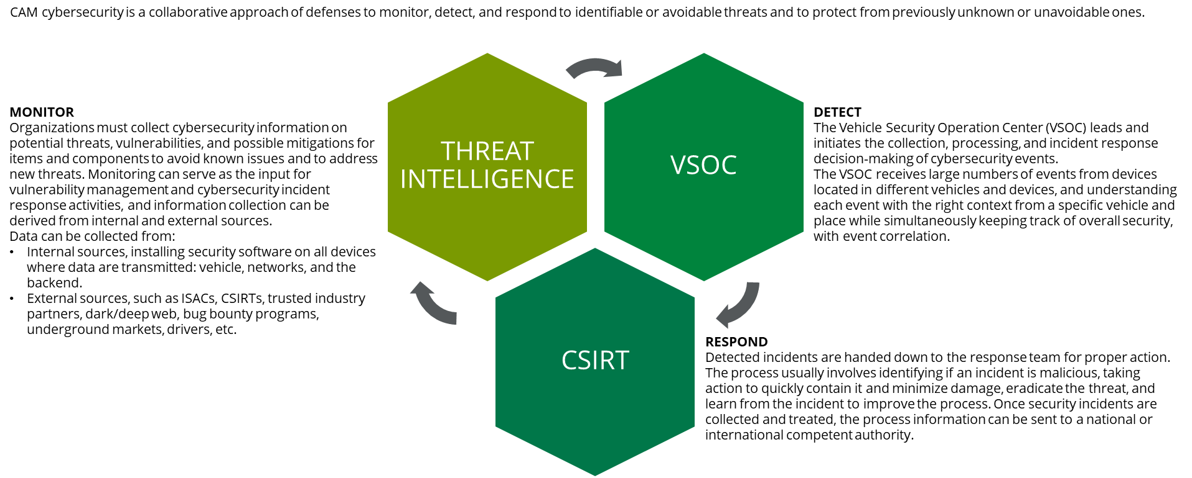
CAM cybersecurity aims to prevent financial, operational, privacy, or safety losses. Safety, reliability, security, and privacy must all start at the outset of the design phase.
Lara Valentín, lvalentin@funditec.es

Slide 4
Outcome: Vehicle SOC
The project is oriented to build VSOC capabilities, enabling cybersecurity for the post-production phase. The core of the project will be a SIEM/UEBA module able to log, categorize, and aggregate relevant data ingested from three different sources:
In-vehicle: trends in automotive ethernet are leading towards 100+ ports requiring 10+ GB of data per hour from 70 to 150 ECUs. This volume of data will increase to nearly 500GB of data per hour once vehicles are truly autonomous. Collecting and analyzing these data poses a security challenge, due to the disparity of firmware, operating systems, languages, communication protocols, and speed of data generation.
Network: other vehicles, the infrastructure (overhead RFID readers and cameras, traffic lights, lane markers, streetlights, signage and parking meters), pedestrians, the grid, 3rd parties cloud services, satellite services, the home, etc. Specialized tools are needed to effectively analyze this network traffic generated by DSRC protocols, WiFI, Bluetooth, 5G, GPS, etc.
Backend servers: cloud services for both the vehicle and user, provided by the OEM.
Using ML algorithms, the SIEM/UEBA will monitor the data to:
Collect information directly from the field to feed cyber threat intelligence centers, ISACs, and CSIRTs, providing robust evidence to other cybersecurity decisions and tools.
Predict cyberthreats to the vehicle before they materialize in an attack and calculate their related risk.
Detect threats and anomalies in near or real-time, alerting the driver when safety is at risk.
The result will be a focused Vehicle SOC, identifying attacks that are unique to the needs of connected vehicles and real end-users. The VSOC will be a security pillar within a larger national or EU body in charge of CAM cybersecurity, such as a Vehicle CSIRT. The VSOC will feed (and contribute to) Vehicle Threat Intelligence sources and redirect attacks to CSIRTs for rapid intervention when general attacks directed to the network or the cloud are detected.
Lara Valentín, lvalentin@funditec.es

Slide 5
Project participants
Existing consortium:
Proposed coordinator: FUNDITEC
Partners / Other participants: to be determined
Looking for partners with capabilities/experience in this field
Lara Valentín, lvalentin@funditec.es

