Slide 1
RESIST NOW
Frédéric LAURENT
frederic.laurent@snowpack.eu
Snowpack
WP leader, S/T provider
Proposal activity: HORIZON-CL3-2022-CS-01-03: Transition towards Quantum-Resistant Cryptography
Frédéric LAURENT, frederic.laurent@snowpack.eu

Slide 2
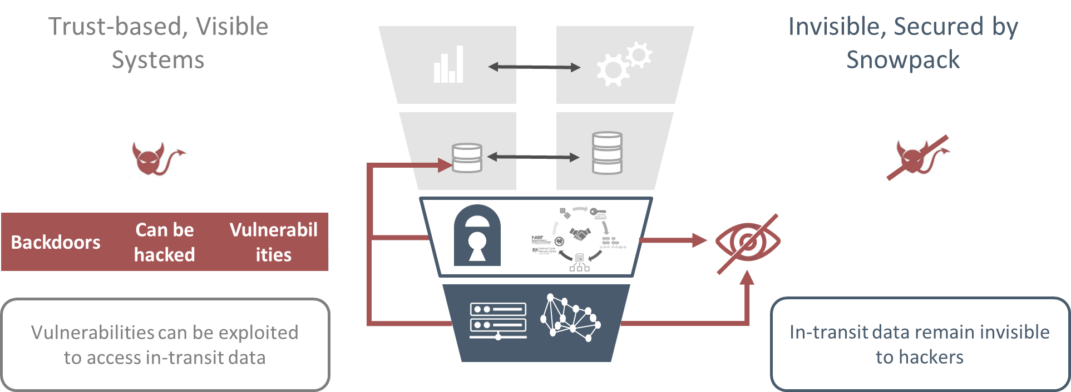
Snowpack in brief
CEA Spin-off created in Q2 2021
Based in Paris (FR) and Vienna (AT)
Founders with extensive FP7, Horizon 2020 experiences as PC members, coordinators, WP leaders, task leaders…
Involved in 4 ongoing EU and national RDI projects
Beta version running in 4 EU countries (FR, DE, NL and PL)

Slide 3
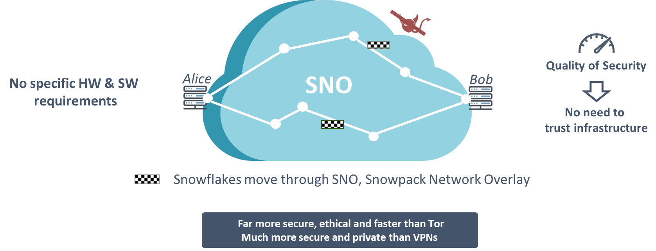
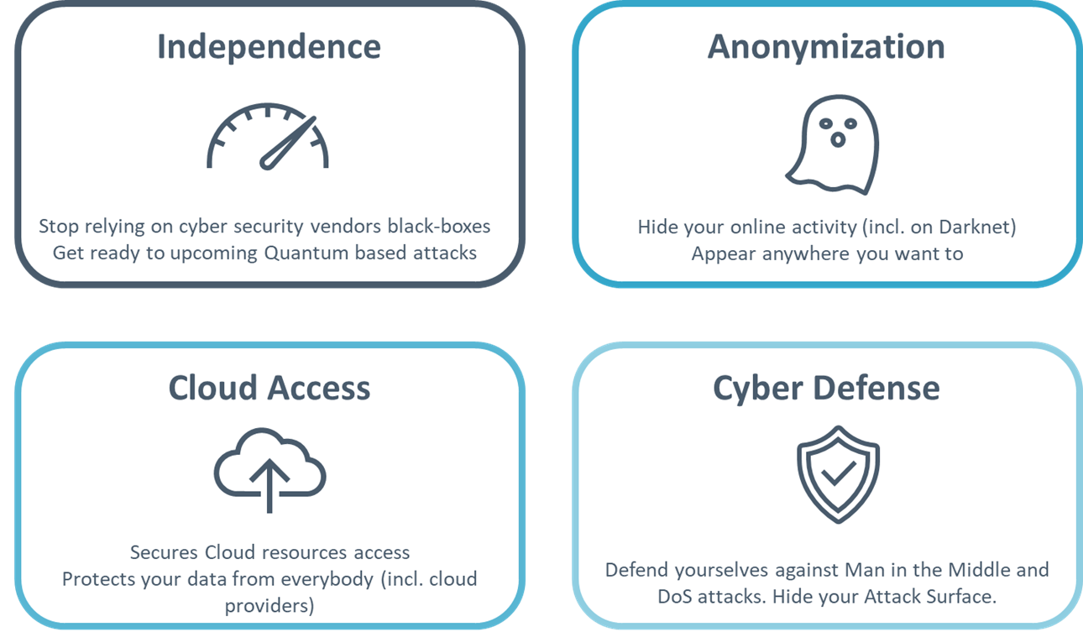
Proposal idea/content (1/2)

Slide 4
Proposal idea/content (2/2)
Evaluating alternative cybersecurity architectures to complement cryptography (incl. quantum-resistant crypto)
Empowering users by moving towards “Beyond-Trust“ approaches and enabling them to measure the Quality of Security, regardless of the underlying infrastructure
Implementing quantum-resistant crypto algorithms in the Snowpack overlay network
Experimenting in various use-cases (incl. CI)
Frédéric LAURENT, frederic.laurent@snowpack.eu

Slide 5
Project participants
Existing consortium:
Proposed coordinator: To be defined
Partners / Other participants: CEA List, others to be defined
Looking for partners with the following expertise/ technology/ application field:
Quantum-resistant experts
Formal verification
Cyber Range
Use-cases
Frédéric LAURENT, frederic.laurent@snowpack.eu

Slide 6
RESIST NOW
Frédéric LAURENT
frederic.laurent@snowpack.eu
Snowpack
WP leader, S/T provider
Proposal activity: HORIZON-CL3-2022-CS-01-03: Transition towards Quantum-Resistant Cryptography
Interest in other topics (as S/T provider and/or use-case) :
HORIZON-CL3-2022-FCT-01-06: Effective fight against illicit drugs production and trafficking
HORIZON-CL3-2022-CS-01-01: Improved monitoring of threats, intrusion detection and response in complex and heterogeneous digital systems and infrastructures
HORIZON-CL3-2022-CS-01-02: Trustworthy methodologies, tools and data security “by design” for dynamic testing of potentially vulnerable, insecure hardware and software components
HORIZON-CL3-2022- INFRA-01-02: CS-01-01: Autonomous systems used for infrastructure protection
Frédéric LAURENT, frederic.laurent@snowpack.eu

