Slide 1
Preparing the Cryptographic Ecosystem for Post Quantum Transition
Erkay Savaş
erkays@sabanciuniv.edu
Sabancı University
Role: Proposal coordinator
Proposal activity: HORIZON-CL3-2022-CS-01-03
Erkay Savaş - erkays@sabanciuniv.edu

Slide 2
Proposal idea/content
Transition to Post Quantum Cryptography
Security by Hardware Design
Extending RISC-V ISA and re-designing its micro-architecture
Generic support for masking for side-channel protections
Generic Side-Channel and Fault Protection
Scalable and versatile hardware support for cryptographic agility
Interface design for easy integration
Tool-chain
A software library
Cryptanalysis for quantum as well as for classical computers
Erkay Savaş - erkays@sabanciuniv.edu

Slide 3
Project participants
Existing consortium:
Proposed coordinator: Sabanci University
Partners / Other participants: Ericsson (Turkey / Sweden, Maxim Integrated (Turkey), KU Leuven (potential), University of Klagenfurt (potential), Bochum University (potential)
Looking for partners with the following expertise/ technology/ application field:
Side-channel analysis
Quantum algorithms
Software tool-chain development
ASIC design
Cryptographic Protocol Design
Erkay Savaş - erkays@sabanciuniv.edu

Slide 4
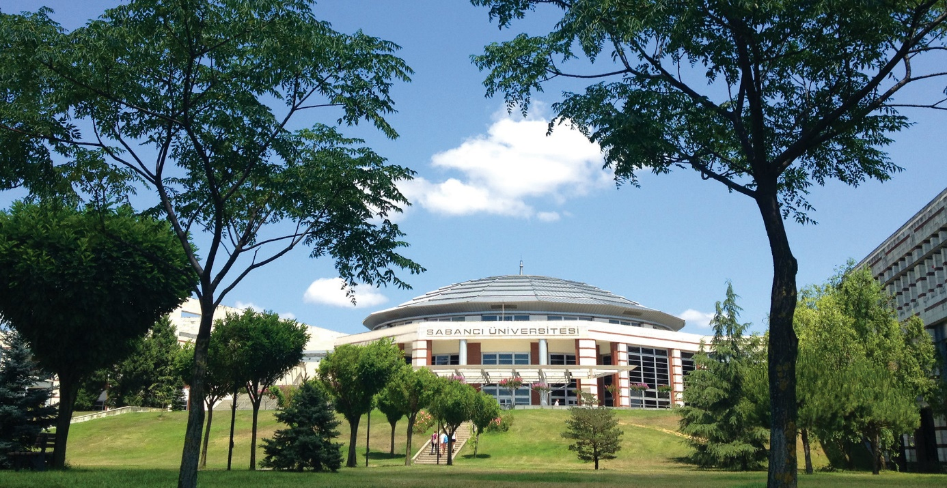
Sabancı University
3 Faculties, 8 Research Centers, 2 Forums
277 Full time Faculty + 135 Part time Faculty
4190 Undergraduate Students
1166 Graduate Students
11 Undergraduate Programs
50 Graduate Programs
15 Doctoral Programs
H2020 Performance
3rd University in Turkey
8,1 M € & 41 projects
2 ERC projects
9 Marie S. Curie Projects
30 Collaborative Projects ~4,5 M €

