Slide 1
SITACC: SITuational Awareness of Citizens in Crisis
Andrzej Adamczyk, Krzysztof Samp
andrzej.adamczyk@itti.com.pl, krzysztof.samp@itti.com.pl
ITTI Sp. z o.o., Poznań, Poland (SME)
Role: WP leader, technical partner
Proposal activity: CL3-DRS-2022-01-01: Enhanced citizen preparedness in the event of a disaster or crisis-related emergency
Krzysztof Samp, krzysztof.samp@itti.com.pl – Andrzej Adamczyk, andrzej.adamczyk@itti.com.pl

Slide 2
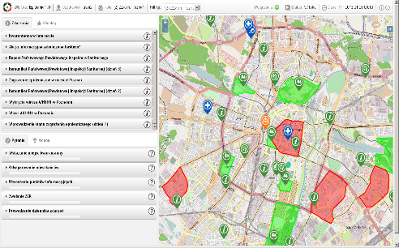
SITACC: Proposal concept (1/2)
Methodology to assess statistical prepardness of citizens to the crisis and other stressful situations incl. scale to measure Situational Awareness Level (SAL) based on e.g. SART (Situation Awareness Rating Technique)
Creation of hypothetical crisis scenarios to produce serious decision games for an awareness exercising in the table-top
ITTI will contribute with PROCeed Games platform (current TRL 9) for creation and playing with two crisis management games: „Flood” and „Epidemic”
PROCeed Serious Games
Krzysztof Samp, krzysztof.samp@itti.com.pl – Andrzej Adamczyk, andrzej.adamczyk@itti.com.pl

Slide 3
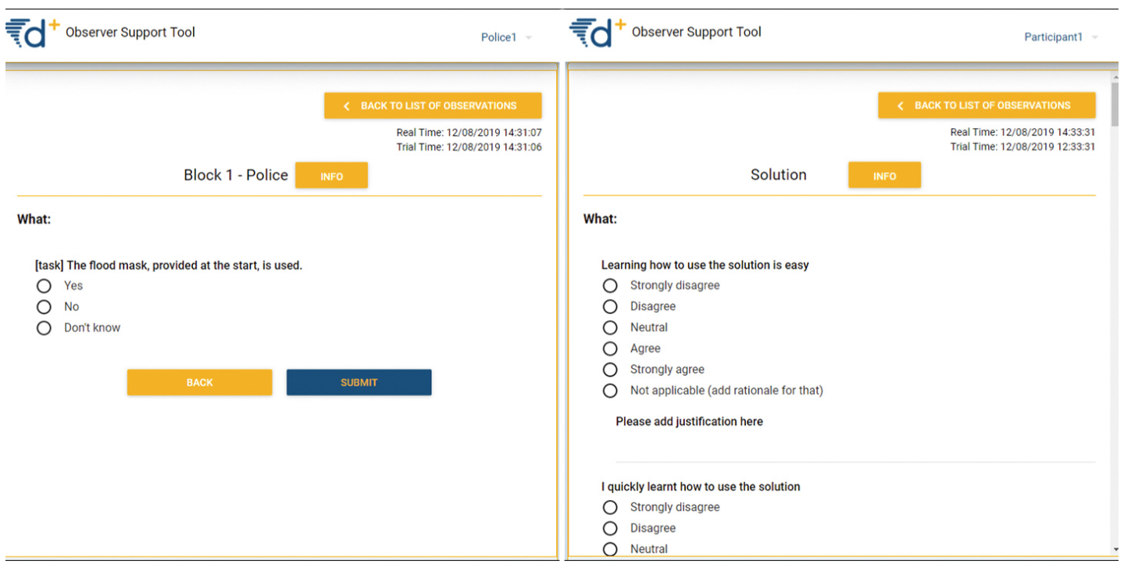
SITACC: Proposal concept (2/2)
Observation Support Tool
Massive game playing by representatives of citizens and observation of players during their play to draw information for evaluation of citizens’ SAL
ITTI will contribute with Observer Support Tool (current TRL 7) developed in DRIVER+ project
Recommendation for SAL cerification activities
Krzysztof Samp, krzysztof.samp@itti.com.pl – Andrzej Adamczyk, andrzej.adamczyk@itti.com.pl

Slide 4
SITACC: Project participants
Existing consortium:
Proposed coordinator: TBD
Partners / Other participants: TBD
Looking for partners with the following expertise/ technology/ application field:
Coordinator of the project
Networks of crisis management practitioners
Organisations representing citizens and communities
Crisis simulation desk-top exercising experts
Social Sciences and Humanities research institutions and experts
Krzysztof Samp, krzysztof.samp@itti.com.pl – Andrzej Adamczyk, andrzej.adamczyk@itti.com.pl

