Slide 1
Improve risk preparedness thru crisis management & simulation tools
Louis Bernard
louis.bernard@crisotech.com
Crisotech (SME)
Role: Contributor, WP leader
Proposal activity:
CL3-2022-DRS-01-02
Louis Bernard - louis.bernard@crisotech.com

Slide 2
Proposal idea/content
To design and implement an enhanced crisis management platform, from simulation, training, crisis management to post-crisis analysis.
Improvement of vulnerability mapping (based on crisis SIG CAIAC)
Integration of simulation capabilities in order to digitally model large-scale crises (natural disaster, industrial, nuclear) (Based on Masa Sword)
R&D around the notion of anticipation and its implementation into the crisis management platform
Pooling and centralization of heterogeneous data useful for crisis management
Sharing and standardization of access for crisis data
Improve crisis anticipation thru AI or Algorithmic crisis modelisation (Based on Masa Sword)
Louis Bernard - louis.bernard@crisotech.com

Slide 3
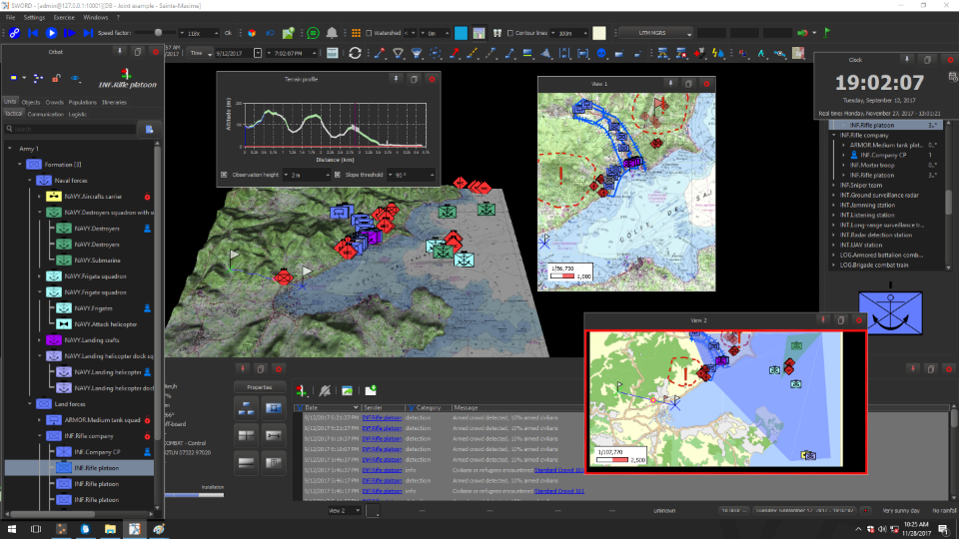
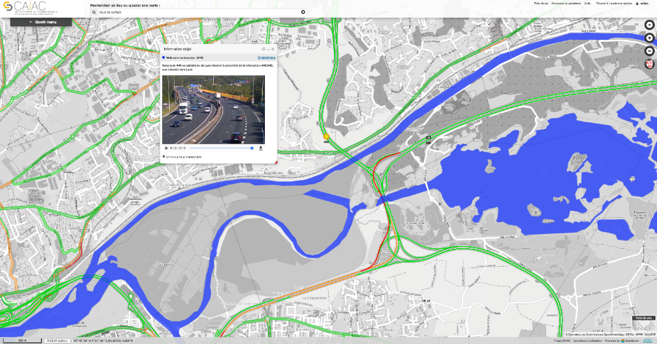
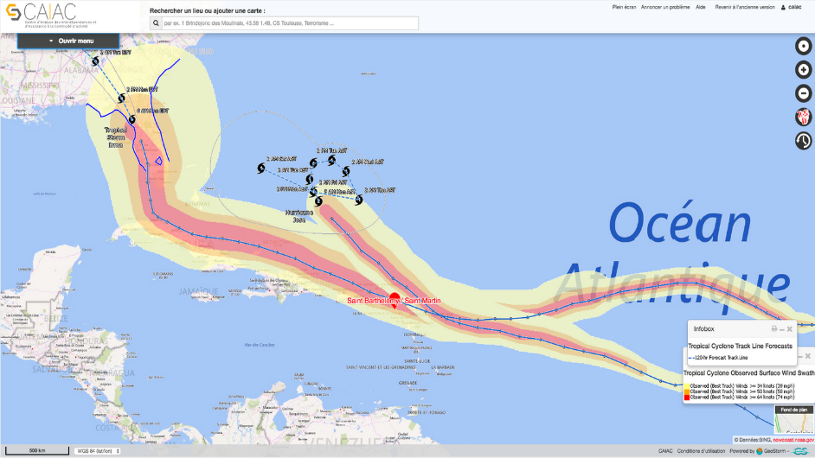
Louis Bernard - louis.bernard@crisotech.com

Slide 4
Project participants
Existing consortium:
Proposed coordinator: To be determined
Partners / Other participants:
Crisotech,
Masa Group,
LEA on the go
Looking for partners with the following expertise/ technology/ application field:
Coordinator of the project,
SHS experts (societal impact modelisation)
LEA (Civil security, law inforcement,…)
Academic Institution (disaster modelisation, impact analysis,…)
Industrial (Modelisation,…)
Louis Bernard - louis.bernard@crisotech.com

