Slide 1
HILPEER High-Impact Low-Probability Events Encompassing Response
Rémi Gelmini – Project Manager remi.gelmini@ensosp.fr
Léa Taillandier – Assistant Project Manager lea.taillandier@ensosp.fr
ENSOSP – The French National Fire Officers Academy
Role: Proposal Coordinator, Project Administrative Coordinator and WP/task leader (training)
Proposal activity: HORIZON-CL3-2022-DRS-01-02 : Enhanced preparedness and management of High-Impact Low-Probability or unexpected events
Rémi Gelmini - remi.gelmini@ensosp.fr / Léa Taillandier - lea.taillandier@ensosp.fr

Slide 2
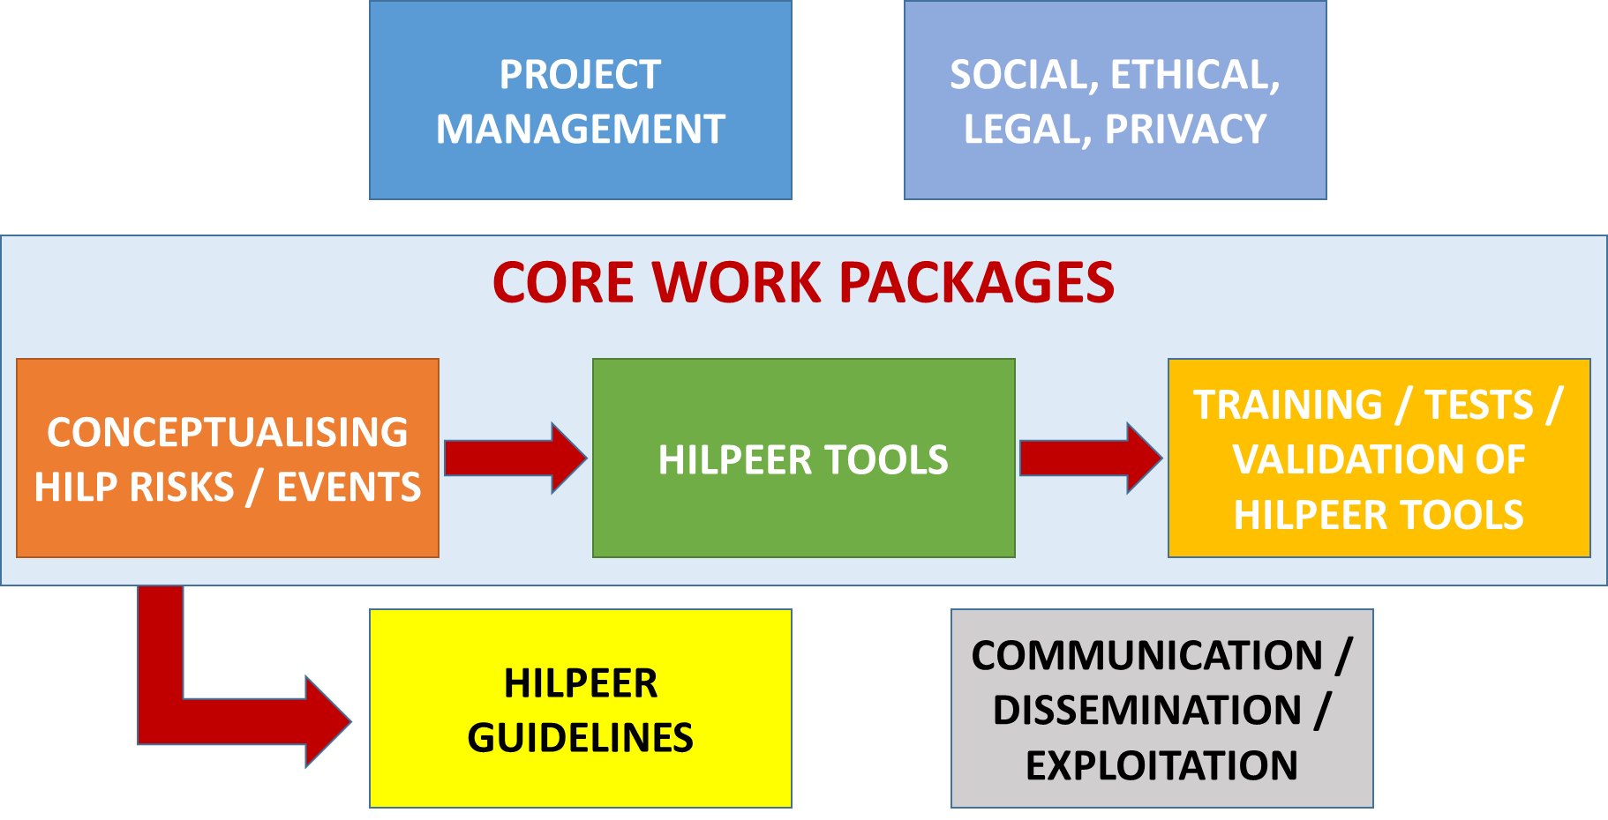
Proposal idea
Aim of the proposal: Improve stakeholders’ preparedness, response and recovery to HILP risks / events at individual, national and international (European) levels
HILP risks / events conceptualization
EU-wide generic definition taking into account the different dimensions of HILP risks/events
Study of past HILP events: impacts, preparedness and response
Tools development
In close collaboration with end-users to maximise relevance
Generic tools: address different kind of impacts irrespective of the causes
Risk assessment and decision-making tools ;
Simulation Tool
Dynamic Database
Ensuring training to HILPEER tools and Performing Tests and Validation of tools
Producing Guidelines and Recommendations
Rémi Gelmini - remi.gelmini@ensosp.fr / Léa Taillandier - lea.taillandier@ensosp.fr

Slide 3
Project participants (1)
Existing consortium:
Proposed coordinator: ENSOSP
Partners / Other participants:
Type of partner | Country | Expertise | Confirmed(?)
Research Centre | FR | Crisis management and training | YES
University | FR | Social Sciences and Humanities | YES
End-User | DE | Crisis preparedness, management | YES
Consultancy | BE | Communication / Dissemination / Events | YES
SME | ES | Development of tools | YES
End-user | GR | Search and Rescue | YES
Rémi Gelmini - remi.gelmini@ensosp.fr / Léa Taillandier - lea.taillandier@ensosp.fr

Slide 4
Project participants (2)
Looking for partners with the following expertise/ technology/ application field:
Scientific coordinator with expertise on Social Sciences and Humanities
Practitioners having the capabilities to organise tests and demonstrations
Organisations from countries having experienced catastrophic events recently such as Germany, Belgium, the Netherlands, Greece, Slovenia, Portugal…
Research centres and providers of innovative solutions in the field of crisis management
Rémi Gelmini - remi.gelmini@ensosp.fr / Léa Taillandier - lea.taillandier@ensosp.fr

