Slide 1

Urban Resilience Against Natural Disasters
Marco Manso
marco@particle-summary.pt
PARTICLE SUMMARY (SME, Portugal)
Role: WP-Leader and Solution Provider (IoT devices, sensor networks, mobile solutions, digital services)
Proposal activity:
HORIZON-CL3-2022-DRS-01-02: Enhanced preparedness and management of High- Impact Low-Probability or unexpected events
Marco Manso, PARTICLE, Portugal (marco@particle-summary.pt)

Slide 2
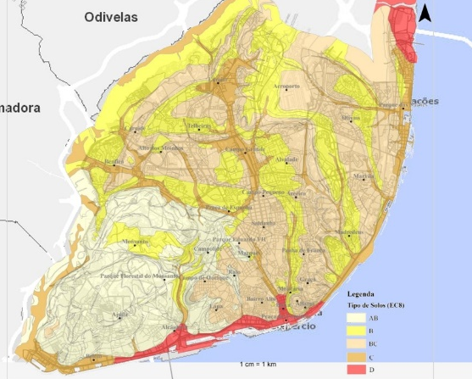
Proposal idea/content
Seismic events can be highly destructive and are unpredictable
  Preparedness and Education are key factors
Many of Lisbon foundations and buildings are old and vulnerable to seismic acitivity (and other natural disasters)
The city is promoting seismic resilience of public and private buildings and urban infrastructure:
  Assess structural integrity of Lisbon’s areas and ellaborate a up-to-date risk assessment geo-reference platform
  Providing an efficient assessment of seismic resilience (at micro-scale, including high-density MEMs deployment) and a supporting digital platform
  Exploit existing information and alerting infrastructures (e.g., bulleting boards, public alerting, etc.)
  Promote citizens’ involvement and education
  Organise and participate (city-wide) yearly simulation events of large disasters.
Marco Manso, PARTICLE, Portugal (marco@particle-summary.pt)

Slide 3
Project participants
Existing group:
  Lisbon Municipality (Câmara Municipal de Lisboa, CML) (gov. entity, end-user, Portugal)
  PARTICLE Summary (SME, Portugal)
  University of Évora (University, Portugal)
WP-Lead role (Use-case in Lisbon, integration with on-going activities, collaboration with local security entities and citizens’ platforms);
Looking forward to join a strong consortium
Marco Manso, PARTICLE, Portugal (marco@particle-summary.pt)

