Slide 1
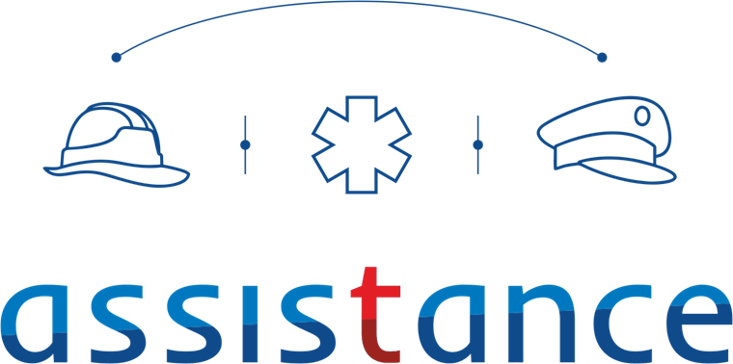
EFFECT- Enhanced First Responders Capabilities for International Cooperation Responding to Disasters
Assoc. Prof. Dr. Zeynep Sofuoglu PhD MSc
Ambulance, Disaster and Emergency Physicians Assoc. (AAHD)
FR-Medical NGO
Role: Proposal coordinator
Proposal activity: HORIZON-CL3-2022-DRS-01-07 Improved international cooperation addressing first responder capability gaps
Since 2008
15 Years Experience
in EU Projects
SMS4EMS
Dr. Zeynep Sofuoglu zeynep.sofu@gmail.com

Slide 2
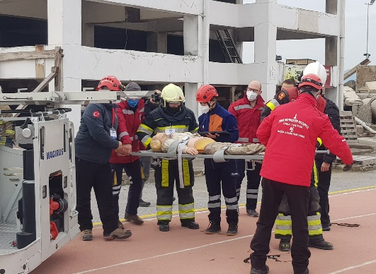
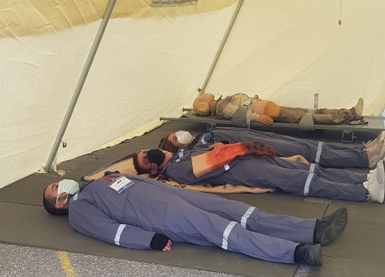
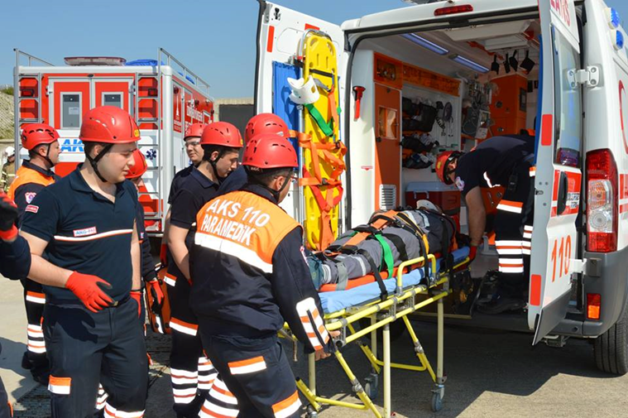
Proposal idea/content
Natural and technological disasters, NaTech, are increasingly causing human and economic losses globally.
The main objectives of the EFFECT Project are to fill the gap in disaster management in international level and enhance the safety and capabilities of all types of First Responders.
The Sendai Framework for Disaster Risk Reduction 2015-2030 list,
global capability gaps have been identified by international expert groups such as the UNDRR and IFAFRI and ongoing and concluded projects of AAHD
KPIs, User requirements, Used Cases, Tailor-made scenarios
Dr. Zeynep Sofuoglu zeynep.sofu@gmail.com

Slide 3
Project participants
Existing consortium:
Proposed coordinator: AAHD (Medical FR)
Partners / Other participants: FRs (Fire fighter, LEA, Civil defense)
Industry, University
«The participation of at least 2 first responders’ organisations from at least 2 different non-EU countries is strongly encouraged.»
Looking for partners with the following expertise/ technology/ application field:
FRs
Technology Provider SME
Communication Provider Industry/SME
Dr. Zeynep Sofuoglu zeynep.sofu@gmail.com

