Slide 1
VIRDIS-ACADEMY Virtual Disaster Academy
Prof. Mehmet Eryilmaz, MD, MBAH
mehmeteryilmaz@hotmail.com
Association for Disaster Research, Turkey
Role: Proposal coordinator
Proposal activity
CL3-2021-DRS-01-09: Enhanced capacities of first responders more efficient rescue operations, including decontamination of infrastructures in the case of a CBRN-E event
Mehmet Eryilmaz, mehmeteryilmaz@hotmail.com Association for Disaster Research

Slide 2
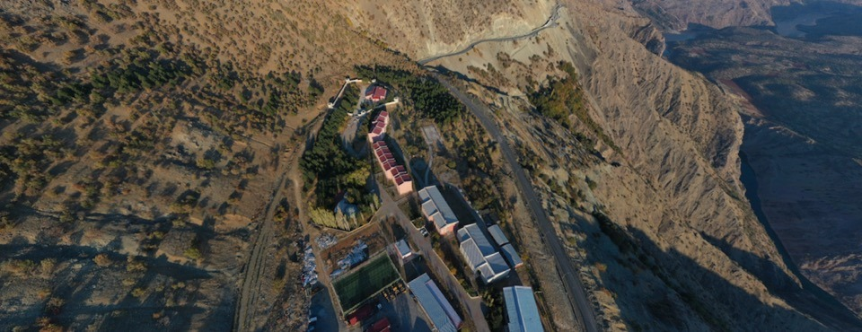
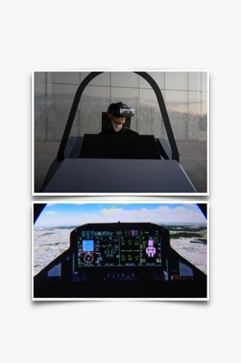
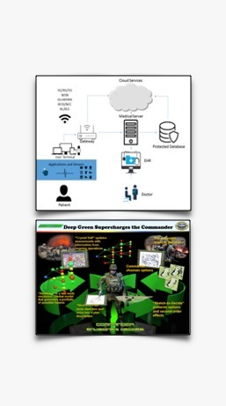
Proposal idea/content
To further increase awareness of disasters with the introduction of Information Technologies and decision support systems.
Mehmet Eryilmaz , MD, mehmeteryilmaz@hotmail.com Association for Disaster Research

Slide 3
Proposal idea/content
It is to provide additional gains to the great successes achieved within the scope of combating disasters by putting into use "Digital Transformation Tools.
Such as electronic learning, distance learning, artificial intelligence, internet of things, augmented and virtual reality and virtual simulation in disaster awareness and education processes.
Mehmet Eryilmaz , MD, mehmeteryilmaz@hotmail.com Association for Disaster Research

Slide 4
Project participants
Existing consortium:
Proposed coordinator: Association for Disaster Research, TR
Partners / Other participants:
Technology-based innovative brand from TR (Unconfirmed)
Learning Management Systems, TR (Unconfirmed)
Academic; NGO; SME
Looking for partners with the following expertise/ technology/ application field:
Experienced with
3D Virtual Maintenance Trainers
Advanced Training Management Information Systems
Debriefing Software Solutions
Image generator for virtual training applications.
End-users.
Mehmet Eryilmaz, MD mehmeteryilmaz@hotmail.com, Association for Disaster Research

