Slide 1
Better understanding the influence of organisational cultures and human interactions in the forensic context as well as a common lexicon
Sylvie NAUDET
Sylvie.naudet@cea.fr
CEA – French RTO
Role: WP leader, technology provider
Proposal activity: CL3-FCT-01-02
but also : CL3-FCT-01-03, 01-05, 01-06, 01-07
Naudet sylvie.naudet@cea.fr

Slide 2
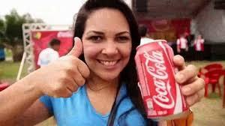
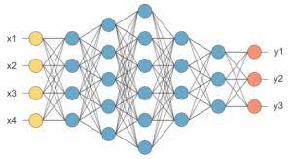
Proposal idea/content
DATA
INFORMATION
TREATMENT
IA Tools
Natural Language Processing
Analysis of massive
multimedia data
texts, videos, images
Search engine
Data Mining
Chatbot
60
Languages
Generic and configurable
Deep Learning Solution
Open Source & CEA propretary

Slide 3
How this technology can address challenges in FCT-01-02
Natural Language Processing (NLP) for extraction and summary of information from heterogeneous data for the creation of a common lexicon to facilitate cross-border exchanges :
Analysis of existing textual documents ➔ NLP ➔ conversion on a common lexicon
Intervention report, forensic investigation report using voice input ➔ NLP ➔ conversion to structured report compatible with a common lexicon
Dynamic adaptation to the evolving aspect of forensic technologies
Challenges
Multilingual
Specific domains
Scarce or heterogenous data

Slide 4
Project participants
Existing consortium: no
Proposed coordinator: no
Looking for a consortium
Name and e-mail of proposer/presenter

