Slide 1
Supporting Reasoning by Deep Semantic AI/NLU algorithms
Gianluca Sensidoni - gsensidoni@expert.ai (Expert.ai SpA)
Role: AI/NLU Semantic Algorithms provider
European Calls: CL3-2022-FCT-01-05, CL3-2022-FCT-01-06, but also other EU calls at Cluster 3
Proposal activity: the ability to understand language and transform it into insights:
A Knowledge Graph as core - a representation of the real world by concepts and semantic relationships + Machine/Deep learning on top (Hybrid NLU)
The Disambiguation – it distinguishes the correct meaning of words and expressions in context (NO Black Box)
The Reasoning process - Hybrid NLU can mimic human reasoning while analysing unstructured contents so to produce Actionable Insight
Gianluca Sensidoni gsensidoni@expert.ai

Slide 2
Proposed NLU features
CL3-2022-FCT-01-05 - Effective fight against corruption :
Entities, Relations and Categories extractions to improve Intelligence picture;
Reasoning by Semantic Patterns and Temporal References to infer modus operandi;
Clustering of similar news so to unveil corruptive practices;
Emotions analysis to understand social and economic impact;
Analysing historical use cases to mitigate future similar events (EX-POST analysis).
CL3-2022-FCT-01-06 - Effective fight against illicit drugs production and trafficking :
Entities, Relations and Categories extractions to improve Intelligence picture;
Emotions analysis to prevent buying/selling actions;
Semantic unknown concepts extractions to discover new trends;
Stylometric analysis to correlate Virtual IDs from Surface to Dark Nets;
Precursors substances discovering used for drugs production.
A validated semantic deduction becomes part of the Knowledge Graph
The same process can start again with a new and wider know-how.
More know-how means more efficient prevention (EX-ANTE analysis)
Information Superiority for Augmented DSS, Simulation & Prediction platform.
Gianluca Sensidoni gsensidoni@expert.ai

Slide 3
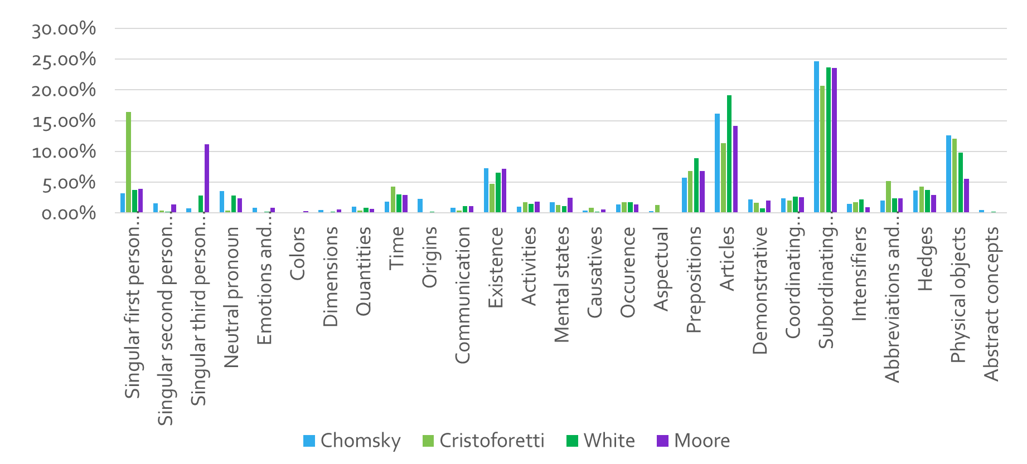
Why Emotions & Stylometric Analysis
Extracting human factor attributes like “the sequences structure of DNA”
Highly distinctive trait for Cristoforetti
Gianluca Sensidoni gsensidoni@expert.ai

Slide 4
Conclusions
Live FREE Demos at:
https://try.expert.ai/
https://intelligenceapi.com/
Looking for Core Partners creating Consortia:
Coordinator
System Integrator with Investigative platform
DarkNets documents acquisition
Expertise on lawful court-proof collection of crime evidence
Domain experts and practitioners
Expertise on Training
LEAs
Gianluca Sensidoni gsensidoni@expert.ai

