Slide 1
NarcoIntel
Marios Zacharias
mzacharias@space.gr
Space Hellas SA
Role: Proposal coordinator, WP leader
Proposal activity: CL3-FCT-01-06 Effective fight against illicit drugs production and trafficking
Marios Zacharias, Space Hellas, mzacharias@space.gr

Slide 2
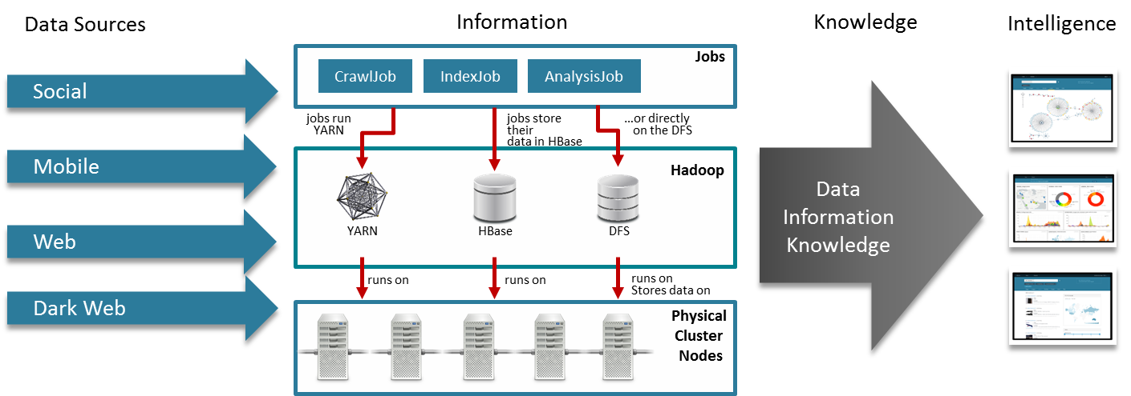
Proposal idea/content
Leverage advanced OSINT techniques for seamless drug intelligence monitoring towards revealing and dismantling entangled drug production & distribution chains
Create solid and lawful court-proof collection of evidence
Introduce new cross-national LEA/Border Guards cooperation models
Marios Zacharias, Space Hellas, mzacharias@space.gr

Slide 3
Project participants
Existing consortium:
Proposed coordinator: Space Hellas SA
Partners’ expertise: OSINT, integrators, legal/ethics, AI experts, 2 LEAs
Looking for partners with the following expertise/ technology/ application field:
Border Guards
Blockchain experts
Drug prosecution units of LEAs
Marios Zacharias, Space Hellas, mzacharias@space.gr

