Slide 1
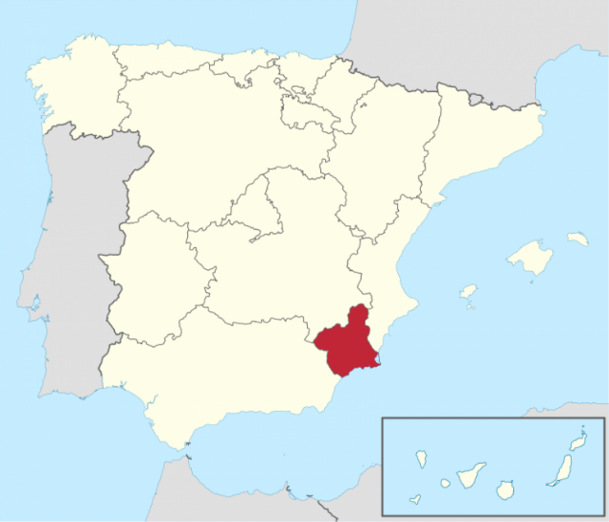
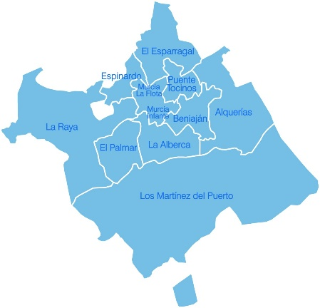
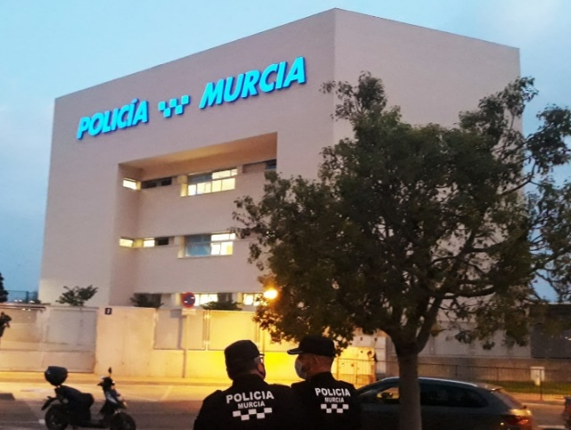
Murcia Local Police
Murcia
Southeast Spain
882 km
Population 450,000
Murcia Local Police
700 police officers
11 Police stations
José Martínez Marín (Murcia Local Police) / proyectospolicia@ayto-murcia.es

Slide 2
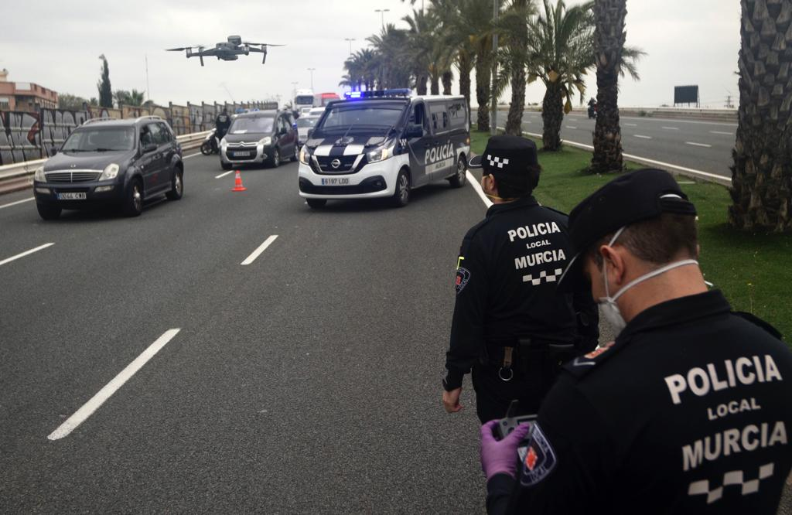
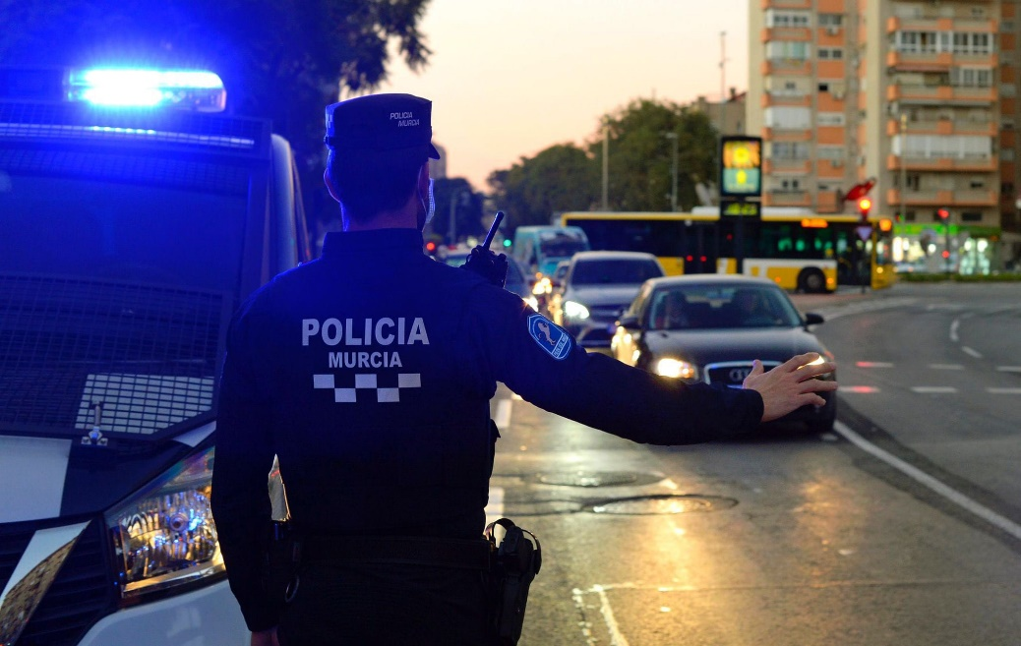
Murcia Local Police
Traffic
Animal protection
Sexual and domestic violence
Civil security
Cybersecurity
Drones
José Martínez Marín (Murcia Local Police) / proyectospolicia@ayto-murcia.es

Slide 3
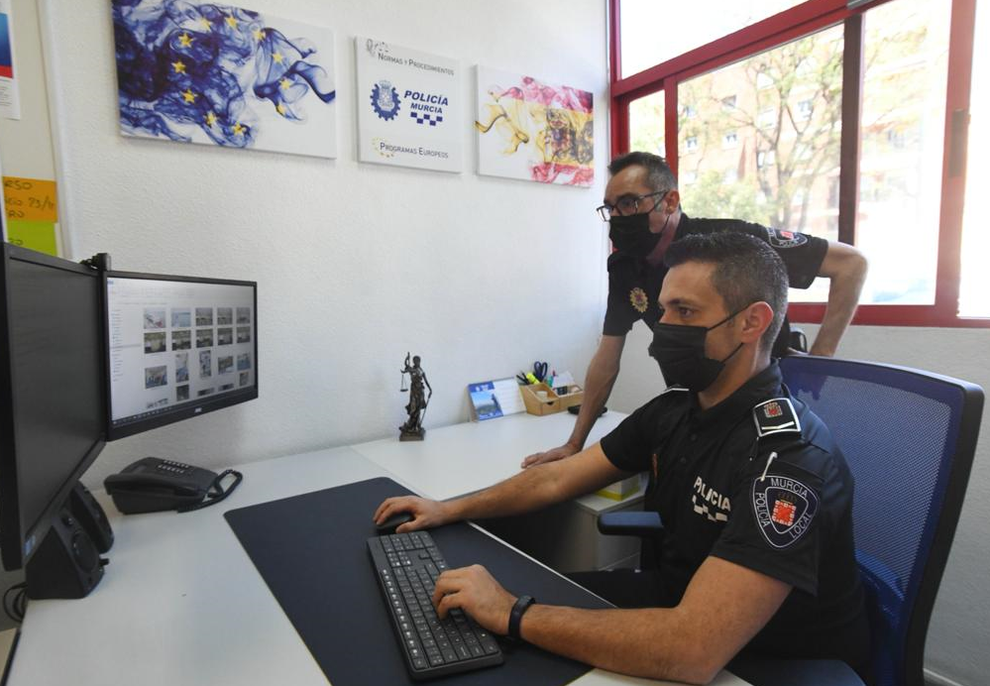
Murcia Local Police
Interests
Cluster 3: Civil security for society
Disaster-resilient societies
Protection and security
Cybersecurity
Fighting crime and terrorism
Resilient infrastructure
Disaster-resilient societies…
Citizens, Equality, Rights and
Values (CERV)
Internal Security Fund (ISF)
Nowadays
7 Horizon Europe calls
José Martínez Marín (Murcia Local Police) / proyectospolicia@ayto-murcia.es
Name and e-mail of proposer/presenter

