Slide 1
Autonomous System for infrastructure protection
Sylvie NAUDET
Sylvie.naudet@cea.fr
CEA – French RTO
Role: WP leader, technology provider
Proposal activity: CL3-INFRA-01-02
But also DRS-01-09
Sylvie Naudet – Sylvie.naudet@cea.fr

Slide 2
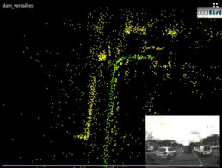
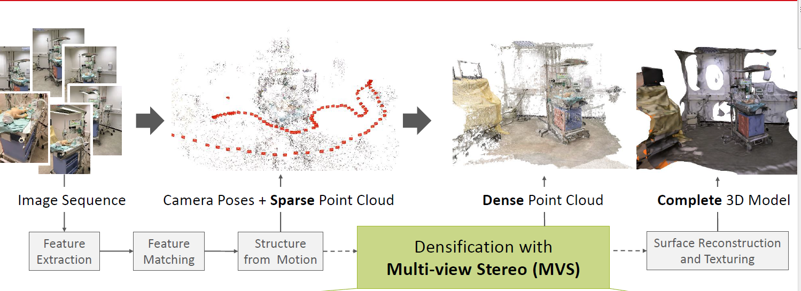
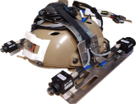
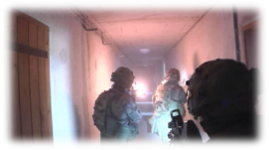
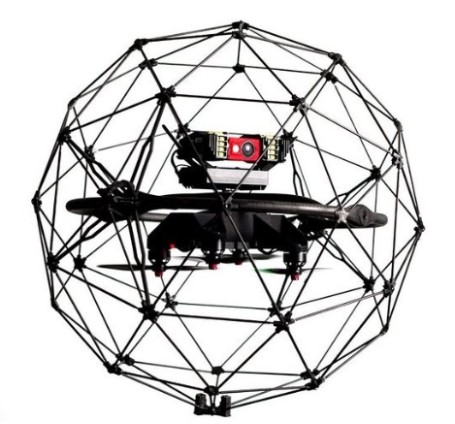
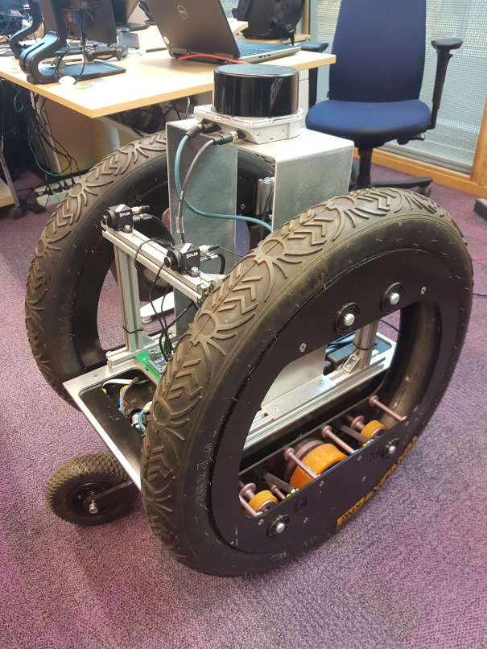
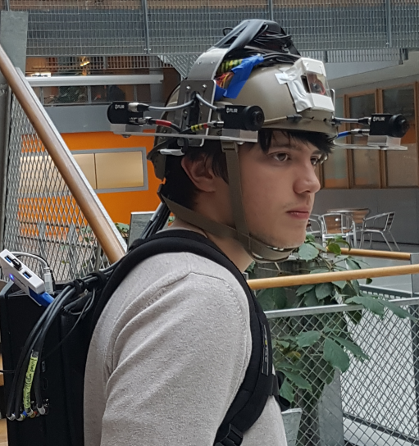
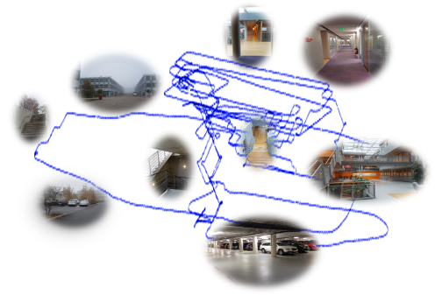
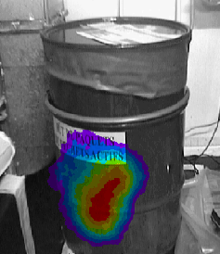
Proposal idea/content
3D Localisation and MAPPING From embedded camera
6 DOF Localisation in GPS denied environments : Indoor and outdoor
Sparse and Dense Mapping
Semantic analysis
^{Sensor fusion :} ^{IMU, RGB or RGBD}
^{ViewPoint recognition}
^{Cartography}
^{Fusion with CBRN sensor}
Visual SLAM
SMI2G 2022, 16-17 May 2022, Brussels
Indoor person localisation for emergency, security and defence operations.
3D cartography of the environnent with
localisation of CBRN threats
Drone localisation for inspection
Autonomous navigation of robot
2
Sylvie Naudet – Sylvie.naudet@cea.fr

Slide 3
Potential use case
Autonomous robot for inspection and for a faster preparation of human intervention (reduce the risk for human) by
creating an automatic 3D mapping of the environnement
detecting and localizing the CBRN threats (by coupling camera and potential CBRN sensors)
3D localization of the Robot in GNSS denied environment
SMI2G 2022, 16-17 May 2022, Brussels
3
Sylvie Naudet – Sylvie.naudet@cea.fr

Slide 4
Project participants
Existing consortium: no
Proposed coordinator: no
Looking for a consortium
Sylvie Naudet – Sylvie.naudet@cea.fr

