Slide 1
EU Strategy and Investments in Cybersecurity
Martin Übelhör

Slide 2
Challenges in Cybersecurity
Geopolitical contest over cyberspace
Large increase in cybercrime
Supply chain security (e.g. 5G)
Expanding attack surface (e.g. IoT; hospitals, vaccine distribution)
Threat from quantum computing breaking “legacy” crypto
Advent of AI
Skills shortage; awareness
Capacity building, resilience
Vulnerability of smaller organisations, SMEs
Info sharing, joint analysis and response
Commercialisation of R&D
Uptake
Single market
Dual use
(…)
Notes:
Resilience: in particular in critical infrastructures
Hence the need for more effective and efficient testing and certification and for SW/HW components made in Europe.

Slide 3
THE EU’S CYBERSECURITY STRATEGY FOR THE DIGITAL DECADE

Slide 4
The EU's Cybersecurity Strategy for the Digital Decade (16.12.2020); 3 instruments (regulatory, investment, policy initiatives) 3 to three pillars
RESILIENCE, TECHNOLOGICAL SOVEREIGNTY AND LEADERSHIP
BUILDING OPERATIONAL CAPACITY TO PREVENT, DETER AND RESPOND
COOPERATION TO ADVANCE A GLOBAL AND OPEN CYBERSPACE
Revised Directive on Security of Network and Information Systems (NIS 2)
Cybersecurity Shield (CSIRT, SOC)
Secure Communication Infrastructure: Quantum, NG Mobile, IPv6, DNS
Competence Centre and Network of Coordination Centres (CCCN)
EU workforce upskilling
Cybersecurity crisis management framework
Cybercrime agenda
Member States’ cyber intelligence
Cyber Defence Policy Framework
EU leadership on standards, norms and frameworks in standardisation bodies
Promote Multi-Stakeholder Internet governance model
Cyber Capacity Building Agenda
EU Cyber Dialogue and Diplomacy Network
I. Sovereignty
IV. Cybersecure EU institutions
II. Capacity
III. Global and open
4

Slide 5
I Resilience, sovereignty, leadership
Infrastructure
Cyber Shield
Ultra secure connectivity
Adopt NIS 2.0
Develop Network of Security Operations Centres
Eg investment in business resilience against cyber-enabled IP theft
5G networks
Internet security
Supply chain autonomy
Skills
Quantum enabled encryption
Complete implementation of Toolbox
Develop DNS4EU
Encourage EUR 4.5 bn investment across digital supply chain through Competence Centre and Network

Slide 6
II Operational capacity: prevent, deter, respond
Joint Cyber Unit
Cyberdiplomacy toolbox
Milestones and process to be set out Feb 2021
Cybercrime
Cyber Defence
Complete Security Union agenda
Strengthen cyber deterrence posture and shared situational awareness
Review the Cyber Defence Policy Framework to increase cyber defence cooperation and coordination
Explore additional measures, and increase cooperation with international partners
Review Implementing Guidelines
Encourage Member States’ cyber defence capability development, notably through PESCO and EDF

Slide 7
III Global and open cyberspace
EU leadership on international norms and standards
Strengthen global capacities to tackle cyber threats
Cooperation with partners
Step-up EU engagement on international standardisation, i.e. ITU
Take forward the Programme of Action to Advance Responsible State Behaviour in Cyberspace
Promote the Budapest Convention and engage in multilateral discussions
Promote and protect human rights and fundamental freedoms online
Strengthen and expand cyber dialogues with third countries, regional and international organisations
Reinforce regular and structured exchanges with the multi-stakeholder community
Form an informal EU Cyber Diplomacy Network with EU “cyber attachés” around the world to promote the EU vision of cyberspace
Develop an EU External Cyber Capacity Building Agenda
Priorities on Western Balkans, EU’s neighborhood and partner countries experiencing a rapid digital development.
Set-up an EU External Cyber Capacity Building Agenda Board

Slide 8
Funding priorities 2021-22
Digital Europe and Horizon Europe programmes

Slide 9
9

Slide 10
Horizon Europe – Work Programme 2021-22 (135m EUR)
Resilient infrastructures and interconnected systems
Security quantification and certification
Hardware, software and supply chain security
Advanced cryptography
AI for cybersecurity reinforcement
Security, privacy, and ethics

Slide 11
Horizon Europe – Work Programme 2021-22: Topics | Budget in mEUR | Call window
Secure and resilient digital infrastructures and interconnected systems | 42
Improved monitoring of threats, intrusion detection and response in complex and heterogeneous digital systems and infrastructures | 21 | 2022
Dynamic business continuity and recovery methodologies based on models and prediction for multi-level Cybersecurity | 21 | 2021
Hardware, software and supply chain security | 35
Trustworthy methodologies, tools and data security “by design” for dynamic testing of potentially vulnerable, insecure hardware and software components | 17.3 | 2022
Improved security in open-source and open-specification hardware for connected devices | 17.7 | 2021
Cybersecurity and disruptive technologies | 22
Transition towards Quantum-Resistant Cryptography | 11 | 2022
AI for cybersecurity reinforcement | 11 | 2021
Smart and quantifiable security assurance and certification shared across Europe | 18 | 2022
Development and validation of processes and tools used for agile certification of ICT products, ICT services and ICT processes
Human-centric security, privacy and ethics | 17 | 2021
Scalable privacy-preserving technologies for cross-border federated computation in Europe involving personal data
Total | 134

Slide 12
Digital Europe programme structure
accelerating the best use of digital technologies
Digital Innovation Hubs
High impact deployments
Building essential digital capacities
High Performance Computing
Artificial Intelligence
Cybersecurity
Advanced Digital Skills
12

Slide 13
Digital Europe work programme 2021-22
European Cyber-shield (147m EUR)
EU cybersecurity resilience, coordination and cybersecurity ranges
Capacity building of Security Operation Centres (SOCs)
Secure 5G and other strategic digital infrastructures and technology
Uptake of innovative cybersecurity solutions in SMEs
Support to the health sector cybersecurity
Support to implementation of relevant EU Legislation (83m EUR)
Network of National Coordination Centres
Cybersecurity Community support
NIS Directive implementation and national cybersecurity strategies
Testing and certification capabilities
Secure quantum communication infrastructure ( 174m EUR)
Skills (incl. Cyber – 166m EUR)

Slide 14
A EUROPEAN CYBERSECURITY TECHNOLOGY & INNOVATION ECOSYSTEM
EU Funding, Capacity-building, Community-building

Slide 15
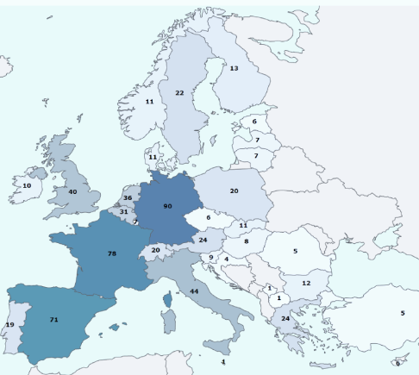
Cybersecurity knowledge and capabilities in the EU
More than 660 expertise centres registered in the mapping of cybersecurity centres of expertise
CYBERSECURITY PRODUCTS AND SOLUTIONS
Up to 30% of the European demand is met by companies headquartered outside the EU.
Europe is the location for the corporate headquarters of only 14% of the top 500 global Cybersecurity providers, compared to 75% for the Americas, 7% for Israel and 4% for Asia.
Cybersecurity products and solutions
ECSO has +/- 250 members

Slide 16
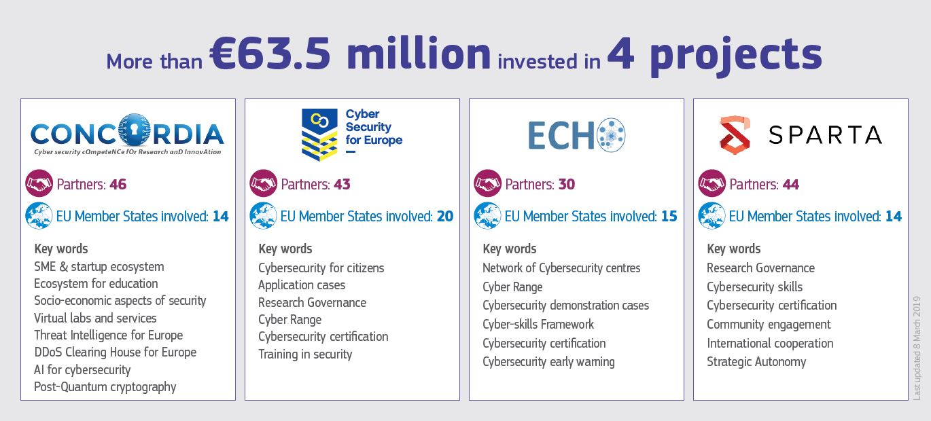
EU pilots helping to prepare the European Cybersecurity Competence Network

Slide 17
THE EUROPEAN CYBERSECURITY INDUSTRIAL, TECHNOLOGY AND RESEARCH COMPETENCE CENTRE & NETWORK
Network and Community
Mission, Objectives and Implementation

Slide 18
EU Cybersecurity Competence Centre and Network
European Competence Centre:
manage the funds foreseen for cybersecurity under Digital Europe and Horizon Europe 2021-2027
facilitate and help coordinate the Network and Community to drive the cybersecurity technology agenda
support joint investment by the EU, Member States and industry and support deployment of products and solutions.
Network of National Coordination Centres (NCCs):
Nominated by Member States as the national contact point
Objective: national capacity building and link with existing initiatives
May receive funding, may pass on financial support
One NCC per Member State
Competence Community:
A large, open, and diverse group of cybersecurity stakeholders from research and the private and public sectors
Provides input to the activities of the competence centre to the work programmes

Slide 19
MISSION
OBJECTIVES
IMPLEMENTATION
Strategic autonomy and global competitiveness
Cyber resilience, capabilities, knowledge and infrastructures
Strategic Agenda for research, innovation, deployment
An inclusive, resilient stakeholder ecosystem
EU funding programmes, voluntary national contributions
Technological capacities and capabilities
Promoting research, innovation, deployment
Cooperation, Coordination; Network and Community

Slide 20
EU Cybersecurity Competence Centre and Network – tasks
Strategic Tasks
Agenda-monitoring and priority-setting
Technical and strategic support to industry and SMEs
Expert advice to the Member States upon request
Use of research results
Support cooperation between relevant Union institutions
Coordination of national centres through the network
Implementation Tasks
Administration of the Network and the Community
Deployment of ICT Infrastructure
Annual work programme, expert advice to the EC
Cooperation with the European Digital Innovation Hub
Synergies of civilian and defence spheres
Promotion of the CCC, CCN and the Community

Slide 21
2021-2027 proposed EU cybersecurity funding sources
Digital Europe Programme
Horizon Europe
€
Co-investment by industry on project basis
Co-investment
by Member States (voluntary)
Network of National Coordination Centres
Capacity building projects
Collaborative R+D projects
Notes:
Co-investment by industry on project basis (mention funding rate flexibility; H2020 LEIT: 100%; ECSEL: 35%); keep normal funding rates for traditional actions
NCCs Coordination costs to be covered by EU budget (for everybody)
NCCs can be beneficiaries for capacity building (in particular DEP, including OPEX); requirement to open up unless sensitive e.g. testbeds, cyber ranges, AI tools, datasets
(…)
Ambition is that all MS participate; small MS: more bang out of your buck;

Slide 22
Network of National Coordination Centres
One NCC per Member State, nomainated by the Member State
May receive EU funding
May pass on EU funding
Objective: national capacity building and link with existing initiatives
Contributes to strategic tasks
Promotes participation in cross-border projects and in cybersecurity action
Provides technical assistance
Coordinates the national, regional and local levels
Asses requests by entities in the Member States
Promotes cybersecurity educational programmes
Advocates involvement of relevant entities

Slide 23
Competence Community
A large, open, and diverse group of cybersecurity stakeholders from research and the private and public sectors, including both civilian and defence sectors which acts cross-sectoral and cross-department
Management of the Community has been prepared through the pilots CONCORDIA, ECHO, SPARTA and CyberSec4Europe
The Centre, Network and Community should help to advance and disseminate the latest cybersecurity products and services
Exchanges with the Centre on developments in cybersecurity
Provides input to the activities of the competence centre to the multiannual work programme and to the annual work programme
Splits up into working groups for regular dialogue
Supports stakeholders at their request, public-private coordination

Slide 24
European Cybersecurity Atlas – the digital knowledge management platform
Enables knowledge management activity related to cybersecurity research
Provides an up-to-date overview of stakeholders and outcomes of research projects
Indicates pressing cybersecurity research areas which guides effective investment across the EU
Collects of cybersecurity knowledge and establishes a cybersecurity taxonomy
Facilitates collaboration among researchers, industry, practitioners on the national and European level

Slide 25
The ECCC ‘Agenda’: process and priorities
#EU #CyberSecurity

Slide 26
Proposed priority areas for cybersecurity capacity support
The ECCC Agenda
Enhance processes and tools for risk management and the management of cybersecurity information
Secure and resilient hardware and software systems, in particular for critical infrastructure protection
Enhance the industrial and market uptake of EU cybersecurity research and innovation results
Advanced cyber security skills: higher education and professional training
Foster the human and social dimension of cybersecurity, and increase awareness
# Call to action

Slide 27
The “Agenda”
NCC Workshop
A comprehensive and sustainable cybersecurity industrial, technology and research strategy
sets out strategic recommendations for the development and growth of the European cybersecurity industrial, technological and research sector
sets out strategic priorities for the Competence Centre’s activities
(…)
(Regulation 2021/887, Article 2(8))
# Call to action

Slide 28
Tools and Assets
Tools and Assets
EU Programmes
Horizon Europe programme
Digital Europe programme
Recovery and Resilience Facility
European Structural and Investment Funds
Joint Actions, i.e. funding actions contained in the ECCC work programme, which are financed jointly by one or more Member States and the Union
Funding modalities: Grants, Procurement, Prizes, procurement of innovative goods and services, etc…)
Central management by the ECCC/EC, or in collaboration with NCCs (cascading funding)
Approaches: Local, regional, national, pan-EU
ECCC projects for collaboration in the Competence Community
# Call to action

Slide 29
The ECCC ‘Agenda’: process
The ECCC Agenda
Horizon Europe Work Programme
Digital Europe Programme Work Programme
Stakeholders input (4 pilots, ECSO, ENISA)
Single Programming Document 2022-2024
Single Programming Document 2023-2025
Agenda
# Call to action

Slide 30
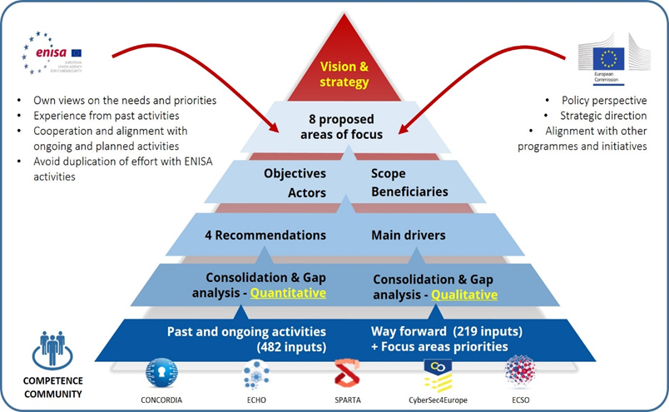
Consultation process so far
Consultation process so far
# Call to Action

Slide 31
Thank you
© European Union 2020
Unless otherwise noted the reuse of this presentation is authorised under the CC BY 4.0 license. For any use or reproduction of elements that are not owned by the EU, permission may need to be sought directly from the respective right holders.
Notes:
Update/add/delete parts of the copy right notice where appropriate.
More information: https://myintracomm.ec.europa.eu/corp/intellectual-property/Documents/2019_Reuse-guidelines%28CC-BY%29.pdf

