Slide 1
Results and recommendations of i-LEAD
On behalf of Patrick Padding – ENLETS Core Group Leader|Netherlands Police
Rashel Talukder – Polish Platform for Homeland Security (PPHS) | ENLETS Secretariat

Slide 2
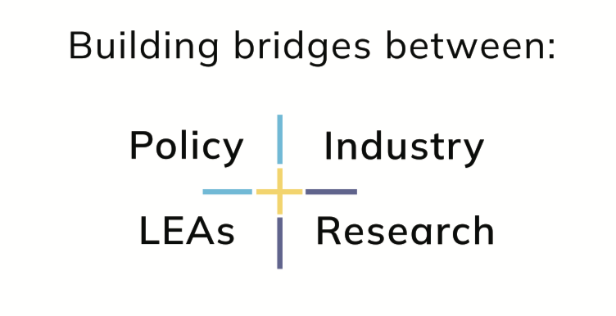
What is ENLETS?

Slide 3
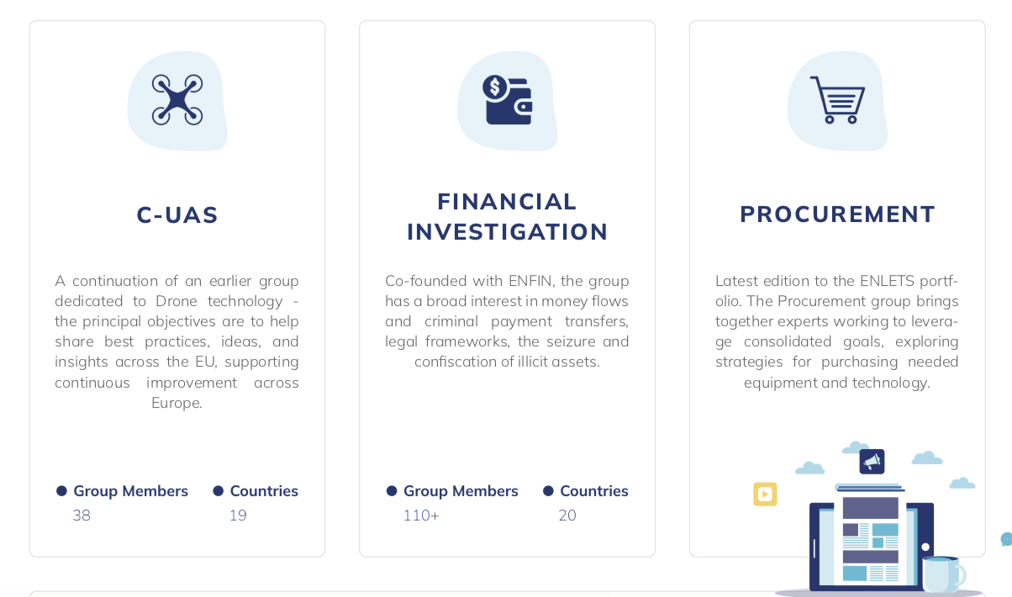
What is ENLETS?
https://enlets.eu

Slide 4
ENLETS as an initiator of EU projects

Slide 5
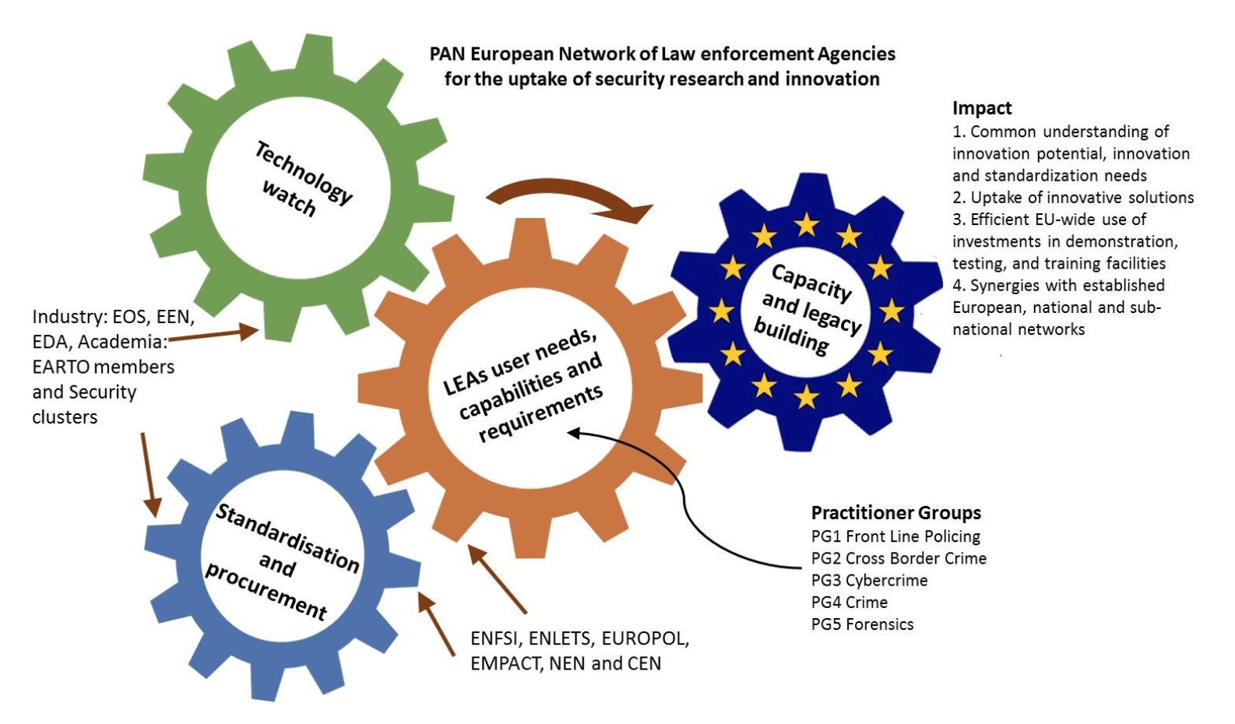
What is i-LEAD?
EU Project – Network of practitioners
September 2016 – February 2023
Budget 3.5 mln Euro
i-LEAD is funded by the European Union's Horizon 2020 - Research and Innovation Framework Programme, under grant agreement no 740685

Slide 6
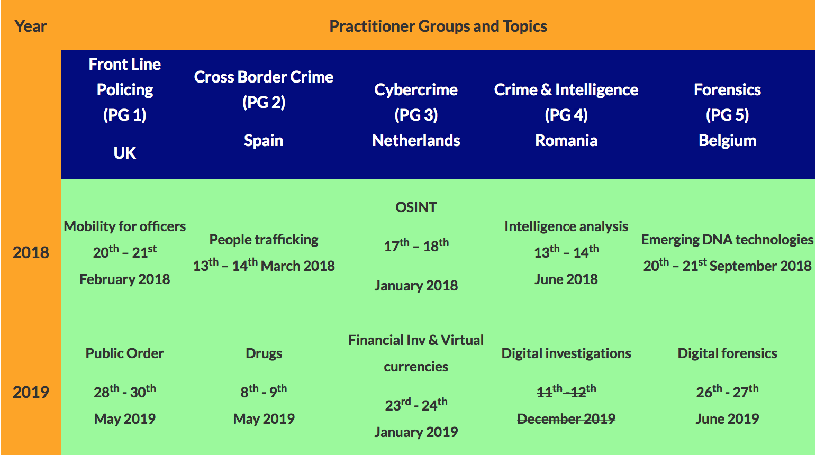
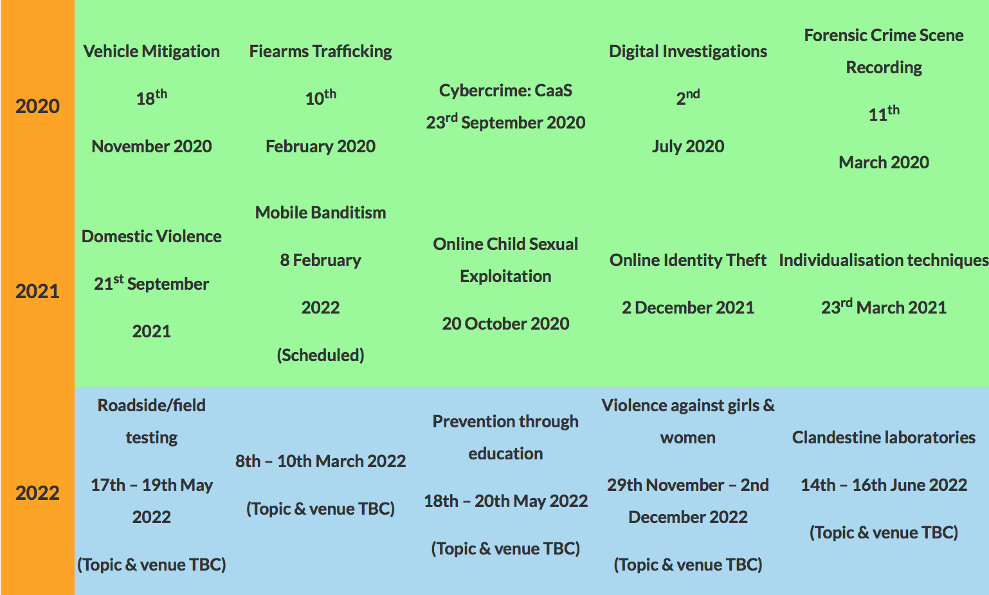
What is i-LEAD?
i-LEAD is funded by the European Union's Horizon 2020 - Research and Innovation Framework Programme, under grant agreement no 740685

Slide 7
Exploitation of i-LEAD results within ENLETS
Who else can use i-LEAD outcomes?
Everyone, because outcomes and methodology are publicly available.
i-LEAD legacy
Overall methodology
Methodology of organising Industry and Research Days
Front Office
Internal communication system

Slide 8
Other results, observations and recommendations
Difficulties with scanning research and market solutions.
​Law enforcement is expecting more than we can offer in the project; a continuous debate on technology is needed (all PG's would like to continue and stay in contact).
LEA’s should be more involved in writing the calls.
The need and potential in front-line policing and public protection is increasing: digital community policing is lacking, infrastructures are changing, behaviour of people is changing and social economical and geo political changes are constantly asking for an adequate organised police (pro-active, efficient, close to society).

Slide 9
Other results, observations and recommendations
​Keep strengthening the existing initiatives and projects from networks and joint ventures to build up a permanent cooperation structure.
​Although 5 years is long time we need to organise and support beyond successful network projects. Allow projects like i-LEAD to foster the outcome, network, legacy also after the project duration.
​Ensure that Member States will be invited as much as possible to carry the work.
​Ensure that new projects in Horizon Europe will examine the baseline capabilities from LEA's before they start to increase the intake from the results delivered by the project. A successful pre-phase study in ENLETS is called “Technology Acceptance Model”.

Slide 10
http://i-lead.eu
project@i-lead.eu
https://enlets.eu
contact@enlets.eu
On behalf of Patrick Padding, ENLETS Core Group Leader and i-LEAD Coordinator
Rashel Talukder, Managing Director, Polish Platform for Homeland Security

